Slide 1


Winter Wildlife Webinar Series: Pollinators and What Plant Species Attracts Them
Presented By: Cierra Williams, Horticulture & Natural Resources Educator
Slides adapted from Sue Gwise, Former CCE Jefferson

Slide 2
Question #1
What pollinators are you familiar with now?

Slide 3
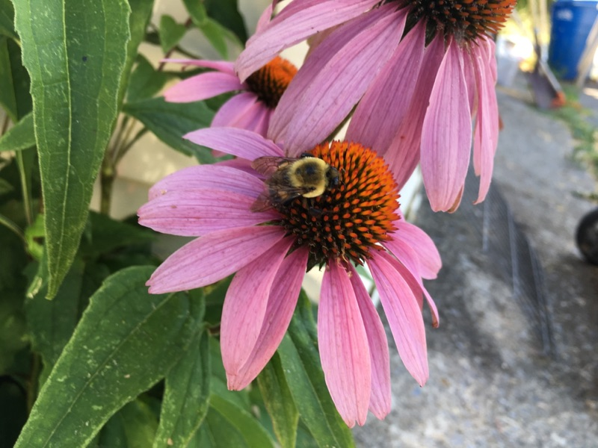
Why do we need to encourage pollinators?
Pollinators are keystone species- a large number of other species depend on them for survival
Abundant pollinators are indicative of healthy ecosystems
Pollination creates a seed → perpetuates the species
80% of flowering plants and most native plants need insects for adequate pollination
Notes:
So why do we need to encourage pollinators?

Slide 4
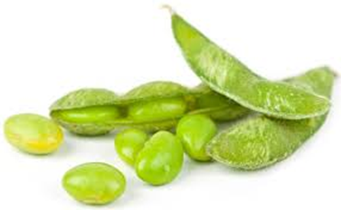
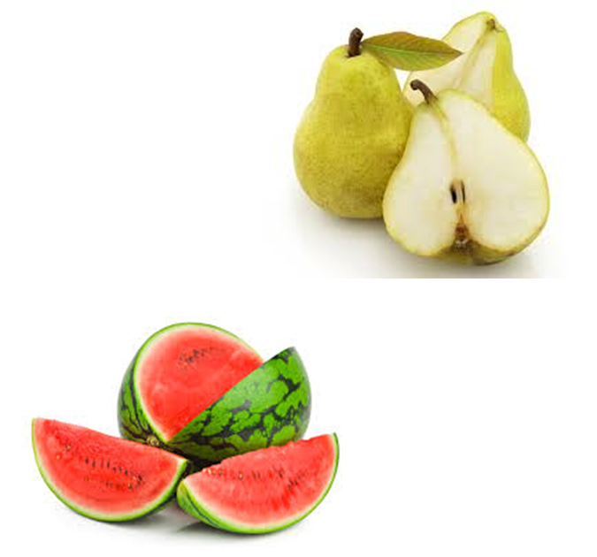
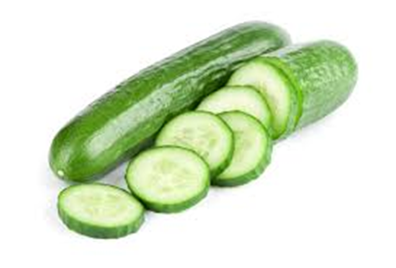
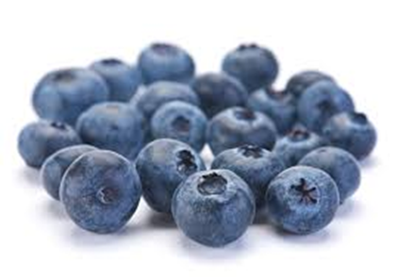
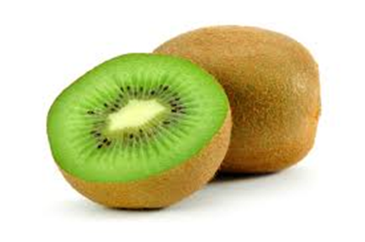
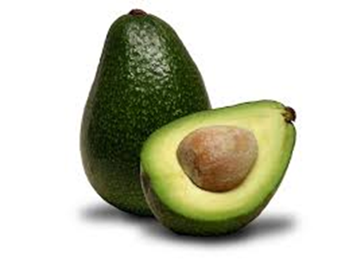
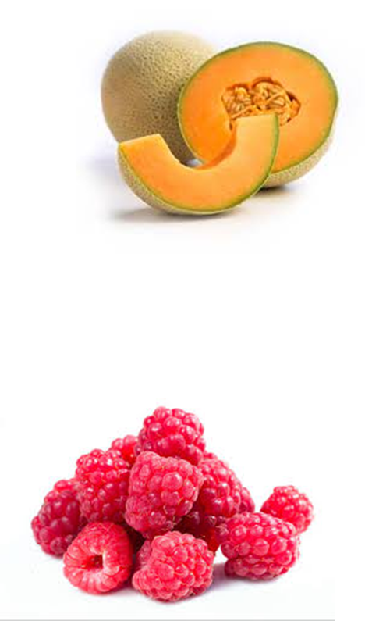
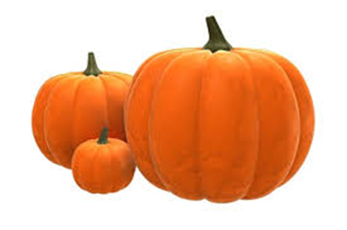
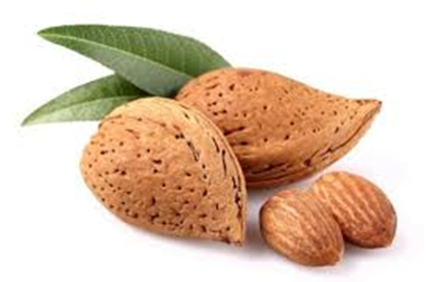
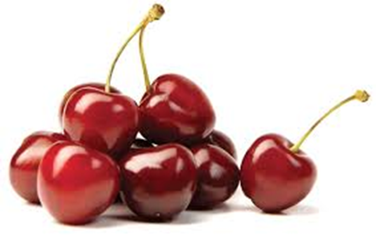
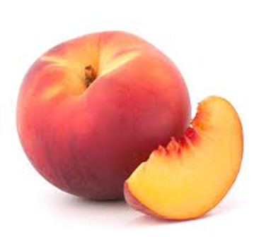
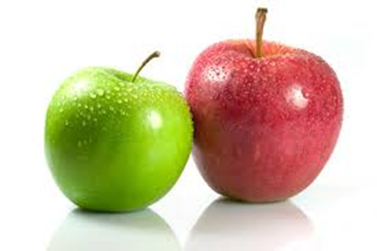
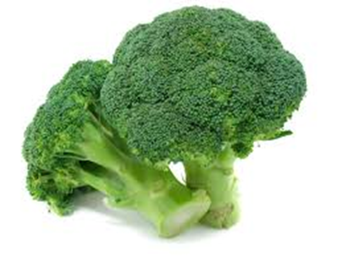
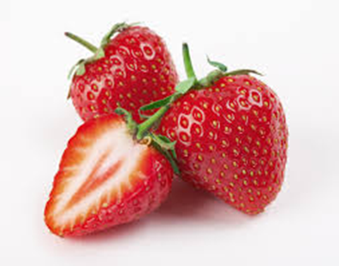
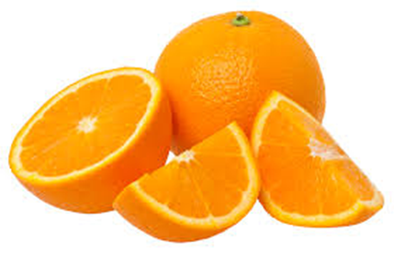
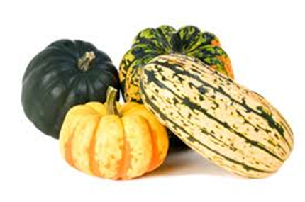
Without pollinators…
Notes:
All of these foods require pollinators to produce fruit. And there are just a few of the species that need pollinators. Pollinators are responsible for 70% of the food on our tables. Without pollinators our produce would be limited and very expensive.

Slide 5
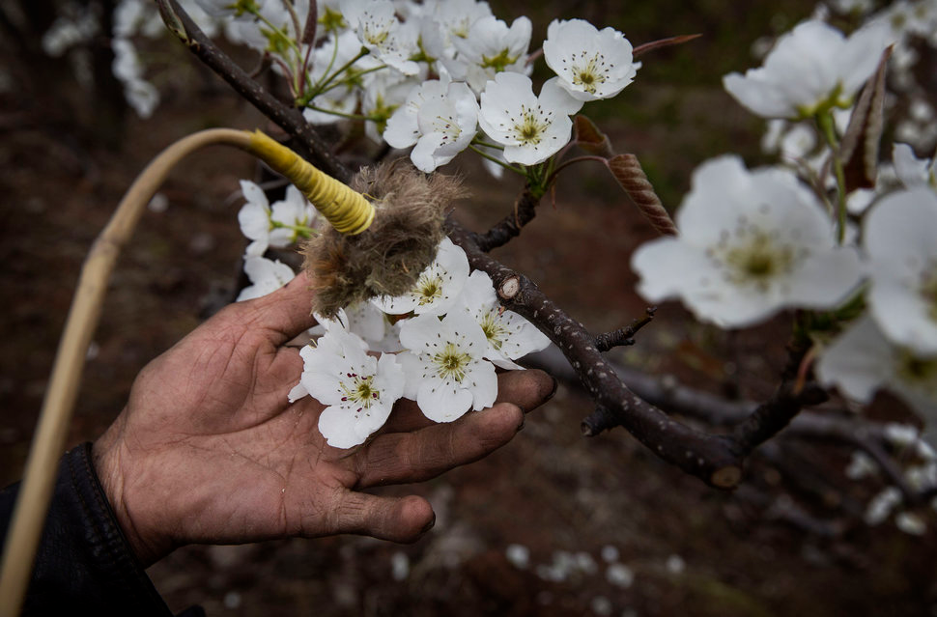
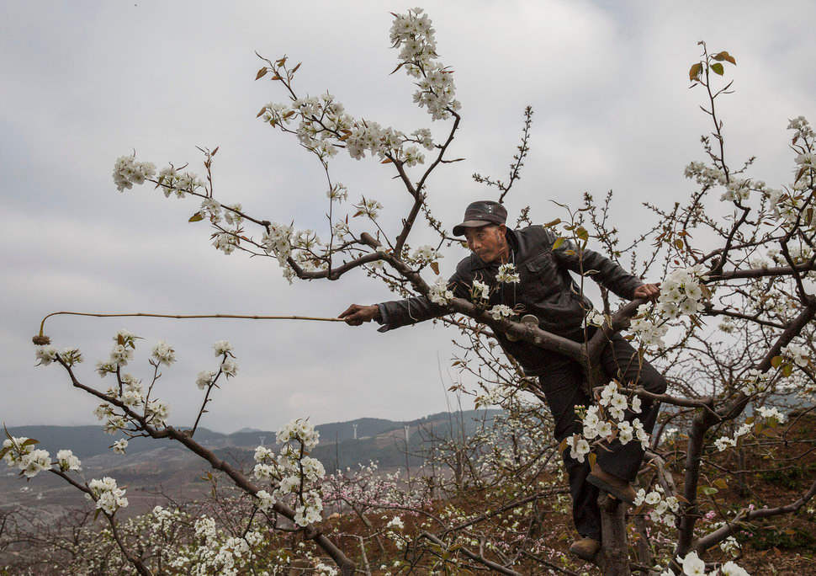
These Photos Capture The Startling Effect Of Shrinking Bee Populations
In rural China, humans pollinate flowers by hand.
Decline of bees forces China's apple farmers to pollinate by hand
After Bee Die-Off, Chinese Apple Farmers Resort to Hand Pollination
Notes:
This has already happened in China. These are just a few of the headlines about the lack of pollinators. The habitat in China has been so degraded that pollination of apple trees is done by hand. If we get to this point, produce will be beyond the budget of most people.

Slide 6

Downward spiral…
Pollinators disappear
Native plants disappear
Invasive plants move in
Birds and animals move out
Notes:
As we degrade the environment, we get into a downward spiral. As the pollinators disappear, the native plants that rely on pollinators disappear because not enough seeds are produced to perpetuate the species. Invasive plants move in leading to monocultures with little diversity. Birds and animals then move out

Slide 7
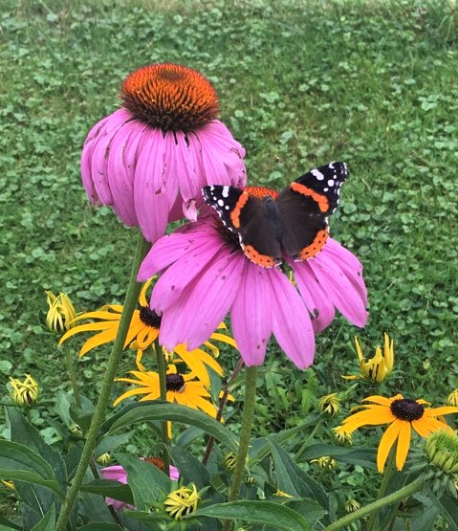
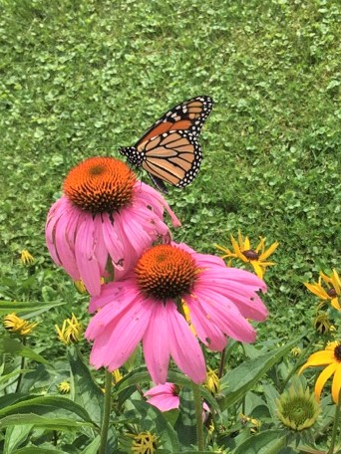
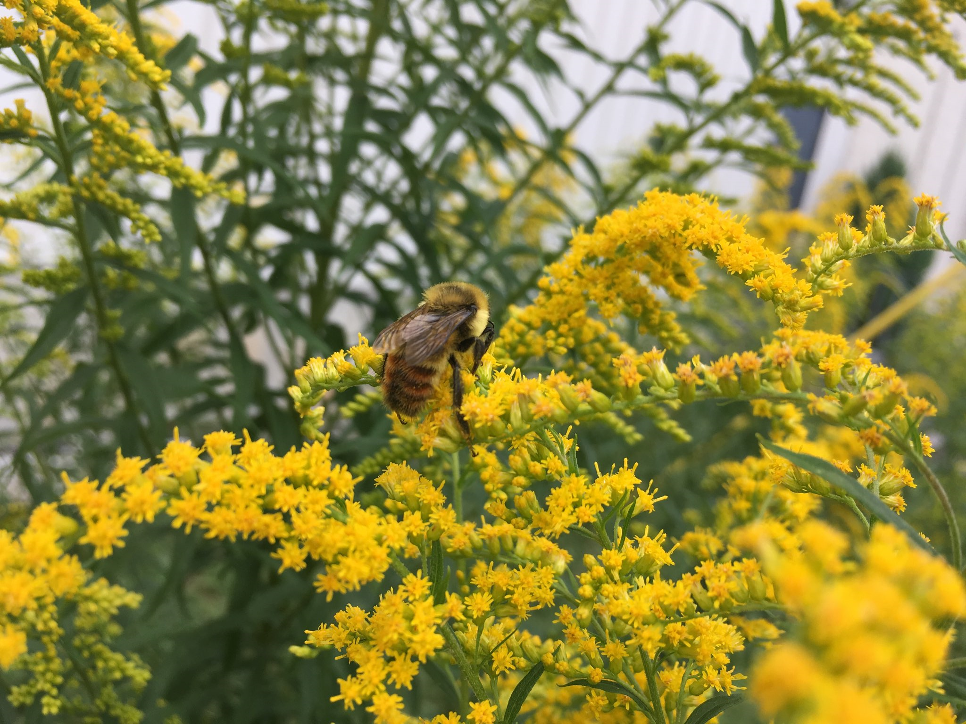
What can you do to support pollinators?

Slide 8
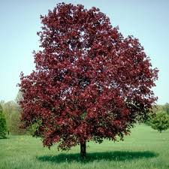

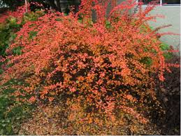
#1- Do not plant invasives!
Norway Maple
>Red or Sugar Maple, Red Oak
Wintercreeper
>Ferns
Japanese Barberry
>Chokeberry
>Ninebark
Burning Bush
>Dogwood
>Chokeberry

Slide 9
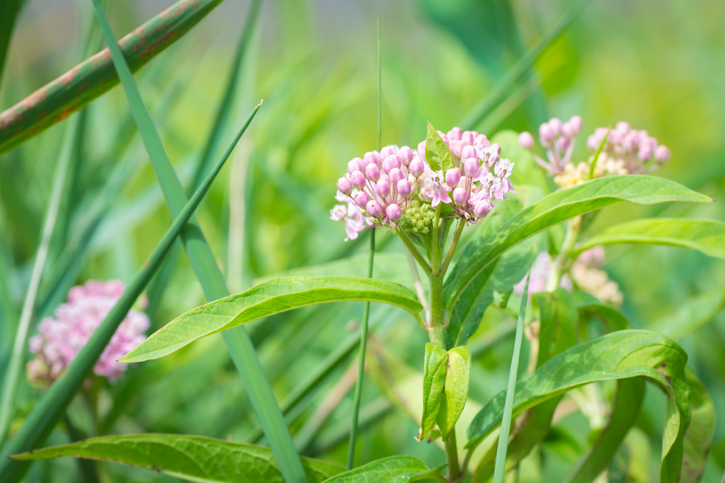
#2- Favor Native Plants
Native plants are adapted to our soil and climate conditions
Native plants have fewer disease and insect issues
Native plants are ‘well-behaved’
A healthy population of native plants can help prevent invasive species from invading an area.
This Photo by Unknown Author is licensed under CC BY

Slide 10
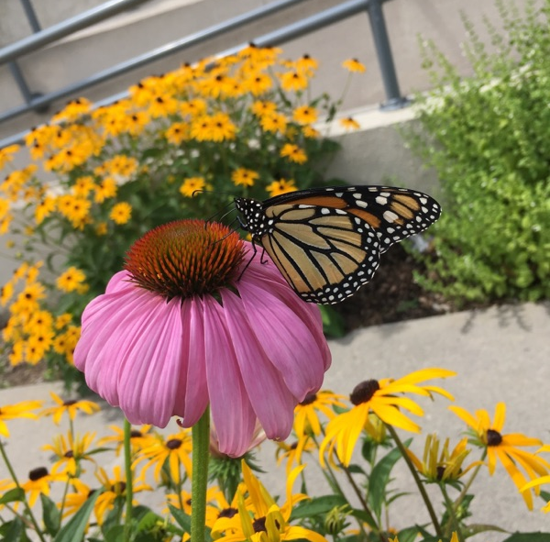
Favor Native Plants…
Our native insects, birds, plants and animals all evolved together
Our native birds and insects know how to use native plants as a result of millions of years of evolution
When we plant native species we are adding something to the environment that native insects and birds recognize and can use for food and shelter.
Non-native plants provide less support to native pollinators!
Notes:
As a result we need to encourage native plants!

Slide 11
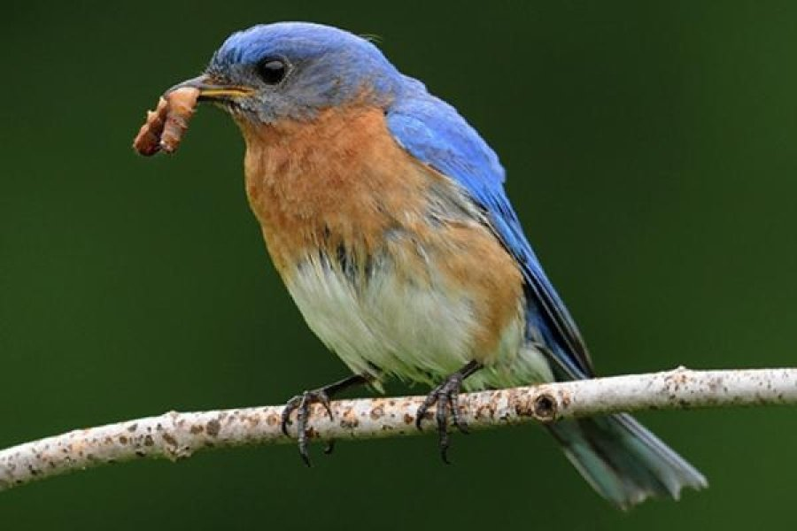
Favor Native Plants…
Native plants attract native insects which attract native birds
90% of all songbirds raise their young on caterpillars that feed on native plants
Notes:
Nesting birds prefer to feed their young high-protein foods- caterpillars are the preferred source of protein. Caterpillars are the immature stage of butterflies and moths which are important pollinators. Adult butterflies and moths lay their eggs on plants that the young caterpillars can consume. Caterpillars don’t just eat any plant. They are very specific as per what they need to eat to survive. By providing these ‘food plants’ in our landscapes we are suppoting butterflies and moths. Food plants are most of native species, especially trees and we will talk about these species a little later in the presentation.

Slide 12
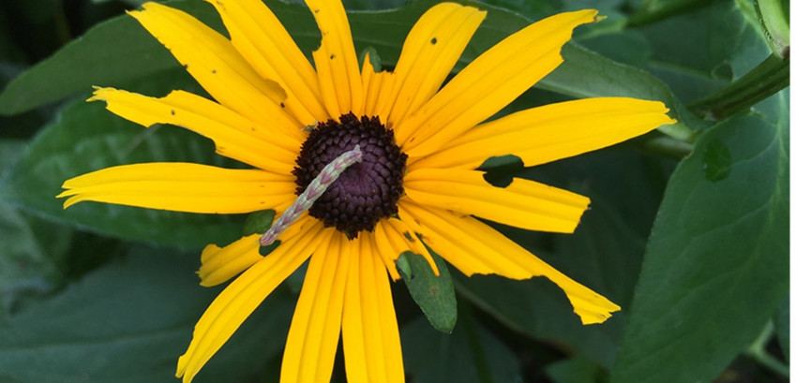
Caterpillars need food plants!
Eating machines
Often very specific as to what they will feed on- native species
Adult females lay eggs on food plants
Caterpillars are an important source of food for nesting birds to feed to their young- Protein
Native food plants → Caterpillars (adult butterflies and moths) → Songbirds

Slide 13
What is “native”?
Plants that were here before colonization (1600)
How do I find out?
Native Plants of New York by Don Leopold
Audubon Field Guides
NY Flora Atlas
There is much debate about nativity!
Notes:
There is some debate on was should be considered native to a region, but the standard ‘rule of thumb’ is that any species that was in the US before 1600 in considered native.

Slide 14
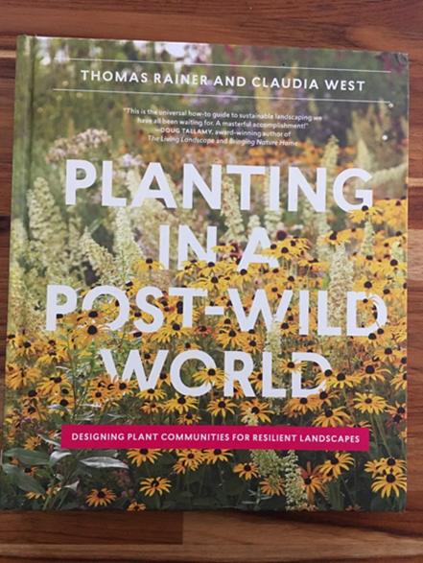
Many non-natives and less desirable plants also support pollinators!
Many introduced weeds and ornamentals are used as food plants
Anything with a flower that has nectar or pollen will support adult pollinators
Don’t get hung up on making sure everything is native!
Be more concerned about invasive plants
Do we even have a native/wild environment anymore?

Slide 15
#3- Diversity is the key!
Different plant families
Trees, shrubs, perennials, vines
Different flower shapes
Different flower colors
Even plants considered boring, lowly, weedy, non-native and annoying have a role to play….

Slide 16
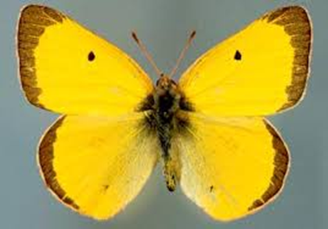
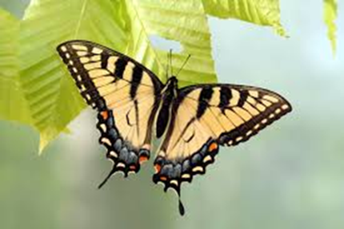
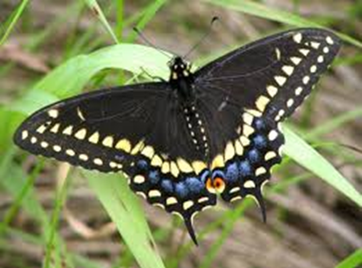
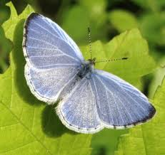
Diversity…Food Plants
Eastern Tiger Swallowtail-
Cherry
Ash
Black Swallowtail-
Carrot Family
Dill
Fennel
Parsley
Queen Anne’s
Lace
Clouded Sulphur-
Legumes
Alfalfa
Clover
Vetch
Spring Azure-
Dogwood
Viburnum

Slide 17
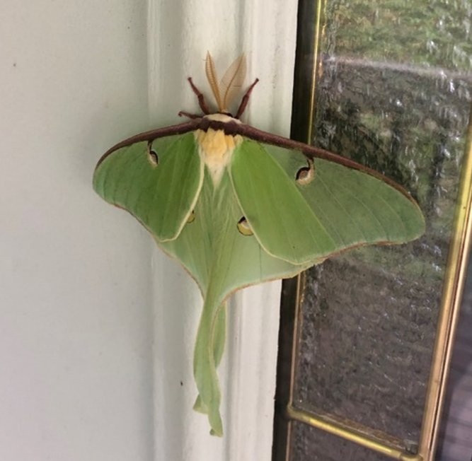
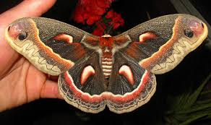
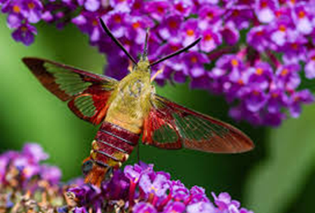
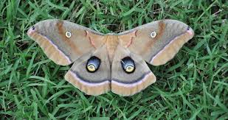
Diversity…Food Plants
Cecropia Moth
Apple
Box elder
Cherry
Lilac
Willow
Poplar
Polyphemus Moth-
Rose
Birch
Willow
Luna Moth-
Birch
Hickory
Walnut
Hummingbird Clearwing-
Viburnum

Slide 18
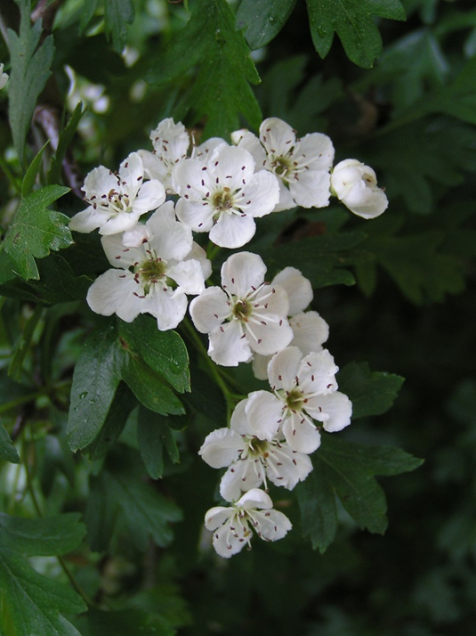
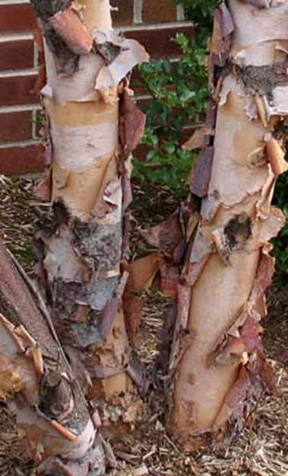
Plant Diversity = Pollinator Diversity!
Deciduous Trees-
Birch
Hawthorn
Serviceberry
Cherry
Poplar
Oak***

Slide 19
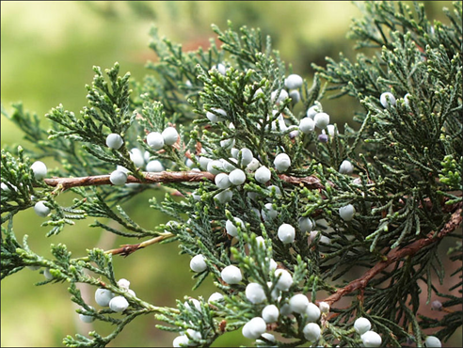
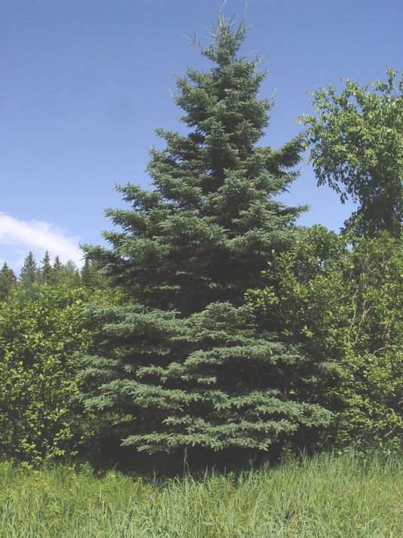
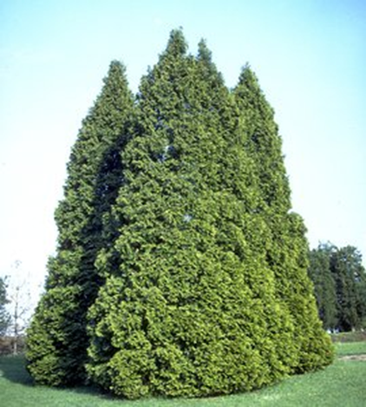
Plant Diversity = Pollinator Diversity!
Evergreen Trees-
Eastern Red Cedar
Northern White Cedar
Pine
Spruce

Slide 20
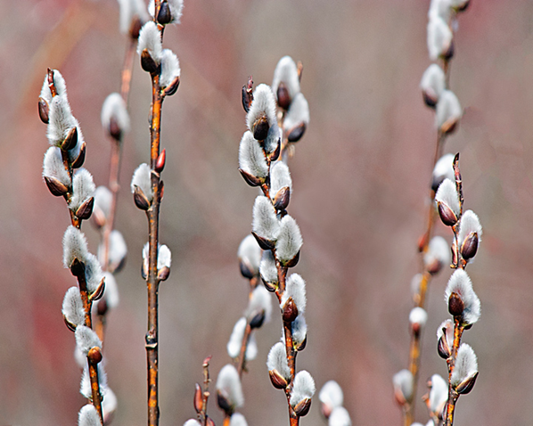
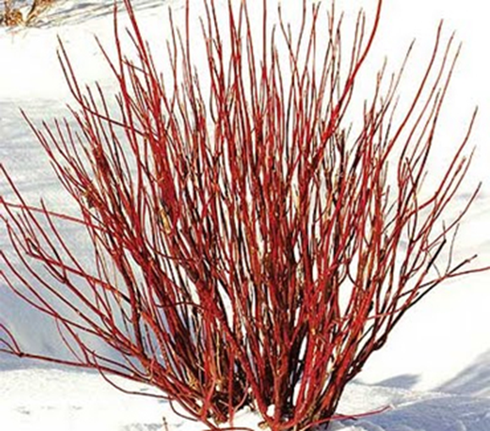
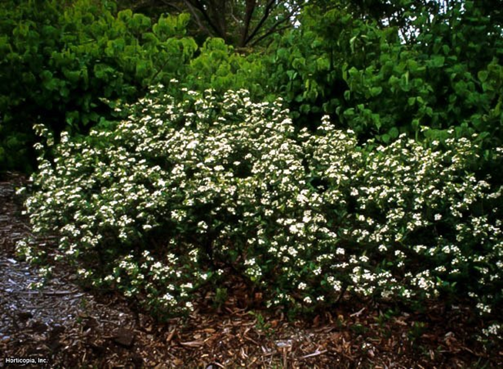
Plant Diversity = Pollinator Diversity!
Shrubs-
Dogwood
Chokeberry
Currant/Gooseberry
Ninebark
Elderberry
Raspberry/Blackberry
Willow
Vine-
Virginia Creeper

Slide 21
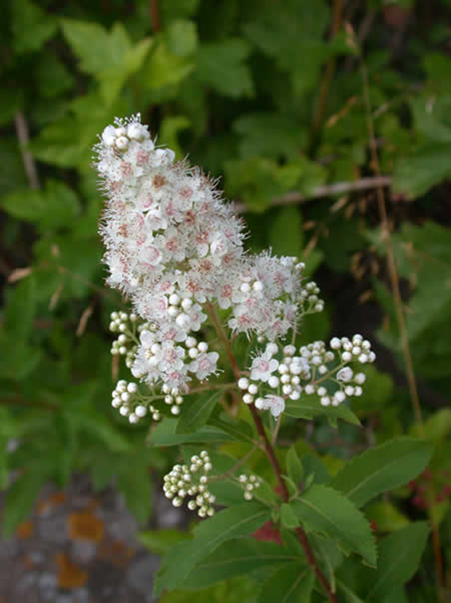
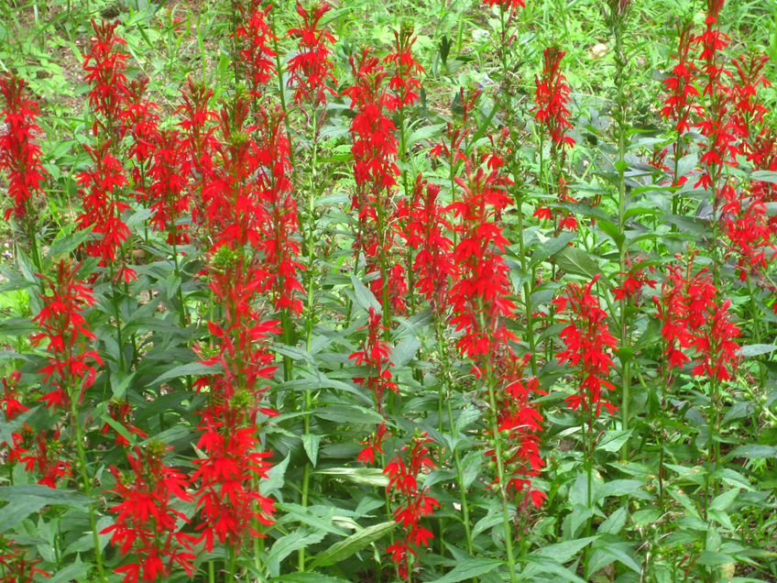
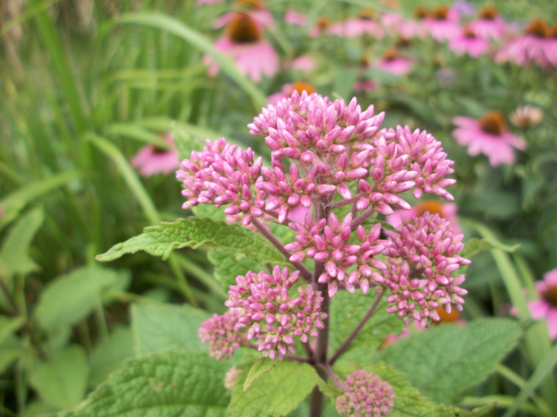
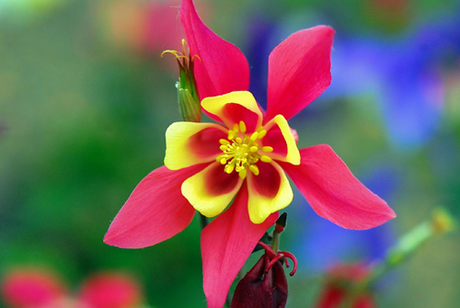
Plant Diversity = Pollinator Diversity!
Perennials (wildflowers)-
Sunflower
Milkweed
Bee Balm
Purple Coneflower
Black-eyed Susan
Meadowsweet
Cardinal flower
Columbine
Joe Pye Weed
Goldenrod

Slide 22
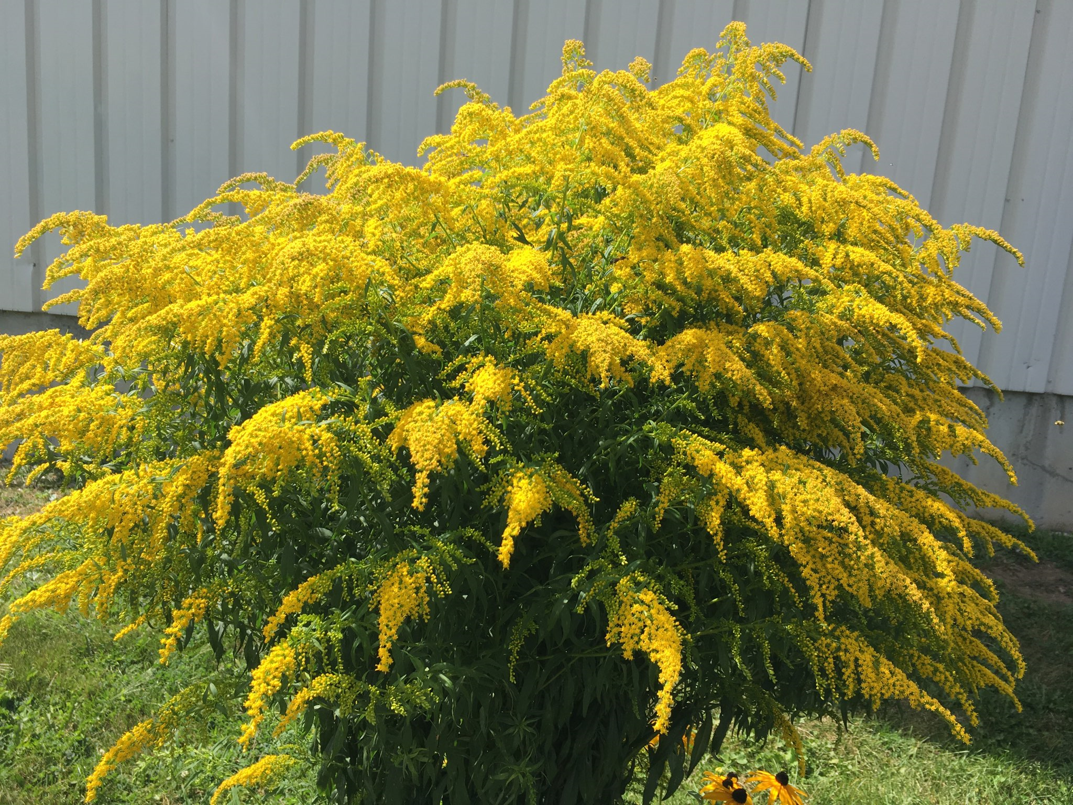

Slide 23


Goldenrod does NOT make you sneeze!
Ragweed does!
Notes:
Ragweed flowers at the same time as goldenrod and is the main cause of allergies. Goldenrod gets blamed because the flowers are showy and stand out. Ragweed is boring and blends in to the environment. Ragweed is also wind pollinated so it puts out large quantities of pollen. Goldenrod requires insects for pollination.

Slide 24






#4- Plant flowers that are attractive to pollinators…
Carrot Family
Daisy Family
Carrot, parsley, celery, dill, coriander
Umbel flower head
Sunflower, aster, daisy, marigold, strawflower, zinnia, dahlia, chrysanthemum
Composite flower head
Notes:
Any plants that have these two types of distinctive flower heads are very attractive to pollinators

Slide 25

How to use flowers for the most benefit
Diversity- use at least 15 different flowering species
Plant diversity = wildlife diversity
Successional blooming- food is available when insects are active
Plant flowers in groups
Use ‘species’ plants rather than hybrids
Attractive flowers:
Butterflies- long, tubular flowers; red, orange and yellow
Moths- night blooming flowers: jimsonweed, evening primrose
Bees cannot ‘see’ red; blue flowers attract bees
Notes:
Discuss each bullet point

Slide 26

#5- Consider the Habitat
The trouble with lawns…
Freedom from pesticides
Insecticides are not selective!
Water
Butterflies like puddles
Provide nesting habitat
Bare soil for ground nesting bees
Trees with loose bark
Snags/unkempt areas provide shelter
PHOTO: Emma Nowak
Notes:
Explain how lawns are monocultures and provide no food for pollinators. Also they contribute to habitat degradation due to the inputs of gas for mowing, and the unnecessary use of pesticides.

Slide 27


#6- Consider less ‘flashy’ pollinators
Pollinators are not just honeybees and butterflies!
Notes:
When most people hear the word ‘pollinator’ they picture a honey bee or a butterfly- these are not the only pollinators we need to support!

Slide 28

Other bees…
Honey Bees are not native!
Native Solitary bees- do not live in colonies
Wood nesting bees
Ground nesting bees
Bumble bees are excellent pollinators!
They have longer tongues than other bees. This allows them to pollinate deeper flowers with complex shapes.
They are generalists that visit a variety of plant species, including native wildflowers and food plants.
Thermoregulation- shivering. Can forage under cold, cloudy, rainy conditions
Buzz pollination
Notes:
Discuss each bullet point

Slide 29


Important pollinators- Flies
Bee Fly
Flower Fly
Notes:
These are bee ‘mimics’, but they are actually in the fly family. They feed on pollen and as a result perform pollination services.

Slide 30





Important pollinators- Beetles
Flower Beetle
Pollen Beetle
Wood Borer
Soldier Beetle
Firefly
Notes:
These beetles also feed on pollen

Slide 31
Bottom Line-
Diversify!
Nurture what you have
Eliminate invasive species
Provide a pollinator friendly habitat- for all pollinators
Do not use pesticides
Favor native species but know that they may not be ideal depending on your setting.

Slide 32

Recommended reading/Resources…
Bringing Nature Home, by Douglas Tallamy
Native Plants of New York, by Don Leopold
Audubon Guides (Trees and Wildflowers)
Caterpillars of Eastern North America, by David Wagner
Pollination Conservation Handbook, The Xerces Society
www.xerces.org
Prairie Moon Nursery prairiemoon.com (MN)
Ernst Seeds ernstseed.com (PA)

Slide 33

Questions? Thank You!
Contact Cierra Williams
315-788-8450 ext. 222
clw247@cornell.edu
www.ccejefferson.org

