Slide 1
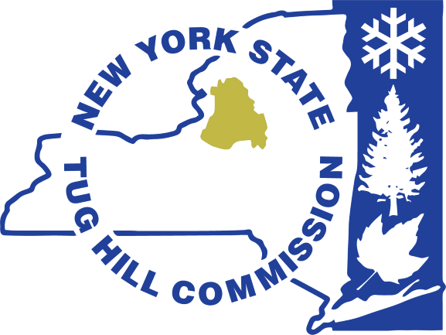
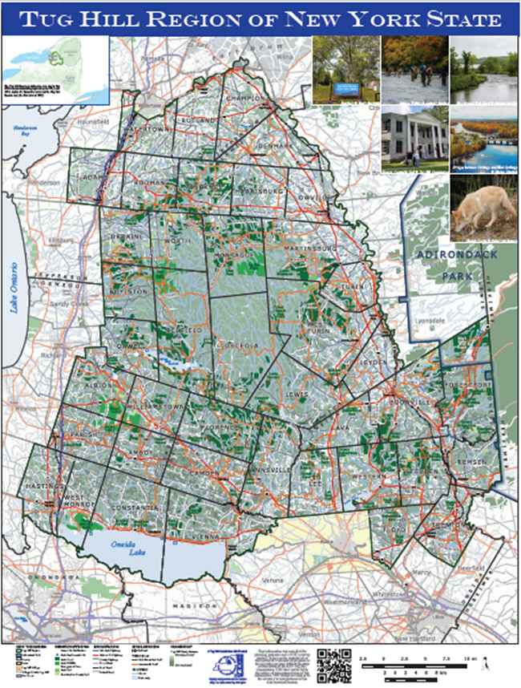
NY’s Changing Energy Landscape and Local Considerations
Katie Malinowski, Executive Director
Matt Johnson, Planning Director
Generation, transmission, and storage of, as well as demand for, electricity in NYS is in a state of flux. The Tug Hill Commission will provide an overview and some insights on what it is observing in the four counties that encompass Tug Hill – Jefferson, Lewis, Oneida and Oswego. The discussion will touch on solar, wind, and nuclear, regional transmission line and storage projects, and what is driving increases in energy demand.

Slide 2
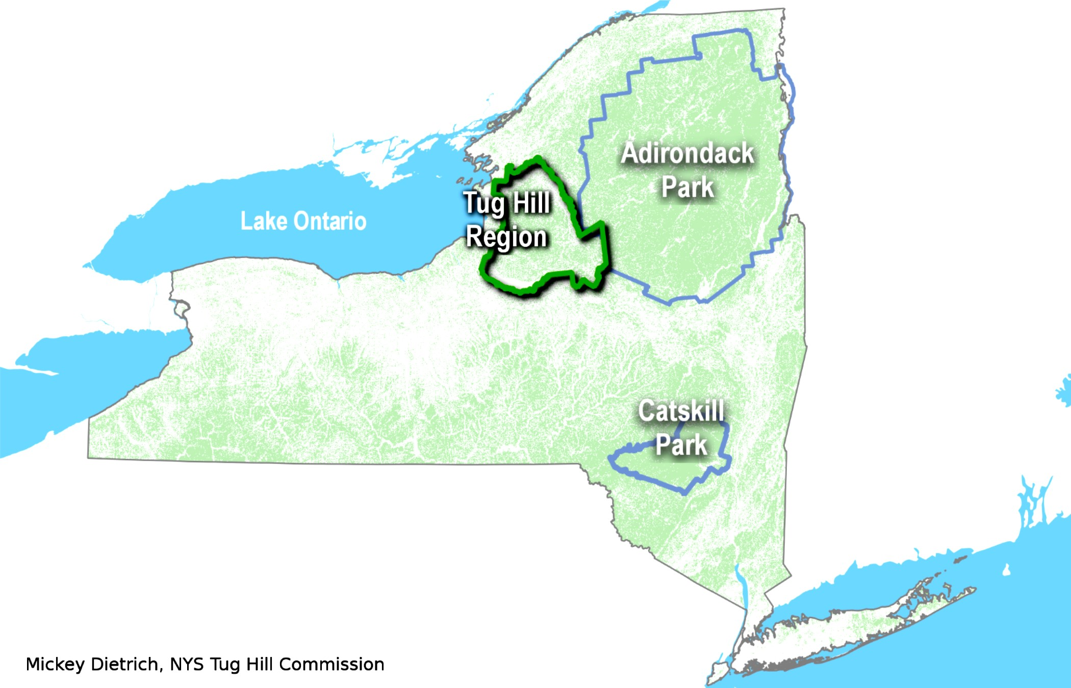
About the Tug Hill Commission
A non-regulatory state agency with a mission “to enable local governments, private organizations, and individuals to shape the future of the Tug Hill region, and to demonstrate and communicate ways that this can be done by other rural areas.”
Governed by a board of 9 unpaid volunteers who must be residents of the region, grassroots, locally driven
Staff of 14 serving a region of 41 towns containing 18 villages, plus, with a combined population of ~100,000 people, 50 people per square mile
Provide day-to-day assistance to local governments, and in turn leverage conservation and sustainable development that benefits the region and state

Slide 3
Takeaways
Demand for electricity is increasing
State policy is creating demand for cleaner energy sources
The four county Tug Hill region already has hydro, wind, solar, and nuclear (Oswego)
Expect more projects to be proposed – i.e. Hydrostor, Sugar Maple Solar, etc.
Another large nuclear is likely to be sited soon
New technologies may come into play (small modular reactors, hydrogen-powered generators, etc.)
Changing federal landscape may affect some clean energy projects, at least in the short term
Notes:
Large economic development projects are increasing demand for energy, as well as electrification required by the 2019 NYS Climate Leadership and Community Protection Act (CLCPA). One of the items in that act was a requirement for zero emissions grid by 2040, which is creating demand for energy sources like wind and solar.

Slide 4
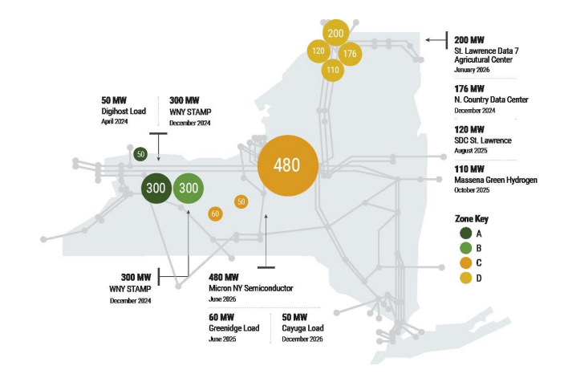
2023-2042 System & Resource Outlook, NYISO, July 2024
Notes:
Here is a visual from the NY Independent System Operator’s 2024 report. The NYISO is a not-for-profit corporation responsible for operating the electric grid. This is slightly dated, i.e. the Massena Green Hydrogen project is no longer moving forward, but gives a good sense of what is going on statewide. Electric energy consumption is projected to increase significantly in response to the economic development and decarbonization energy policies. Siting new generation resources near large loads is likely to be prioritized. Zones are also important to pay attention to, as they manage the way electrons flow.

Slide 5
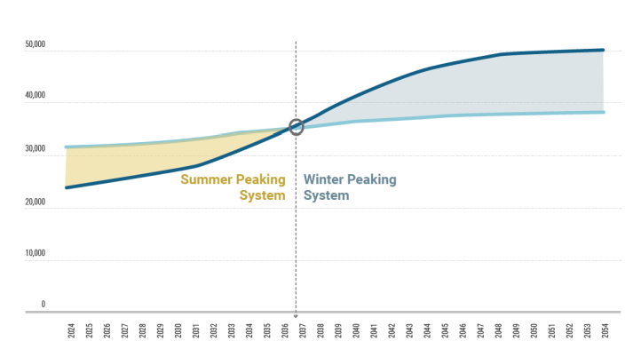
2023-2042 System & Resource Outlook, NYISO, July 2024
Notes:
Additionally, we are moving toward an electrical system that no longer peaks in the summer due to air-conditioning demand, but peaks in the winter due to heating demand. The inflection point is anticipated to be around 2036-37.

Slide 6
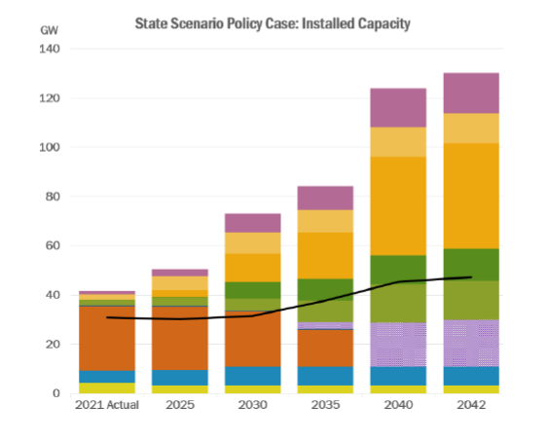
2023-2042 System & Resource Outlook, NYISO, July 2024
Notes:
Bottom to top – nuclear, hydro, fossil fuels, other, DFER (Dispatchable Emissions-Free Resources, such as long-duration batteries, small modular nuclear reactors, hydrogen-powered generators, and fuel cells), off-shore wind, utility solar, behind the meter solar, . This Outlook projects that at least 20 GW of DEFR capacity would be needed by 2040 to replace the current 25.3 GW of fossil generation to support the achievement of CLCPA mandates.

Slide 7
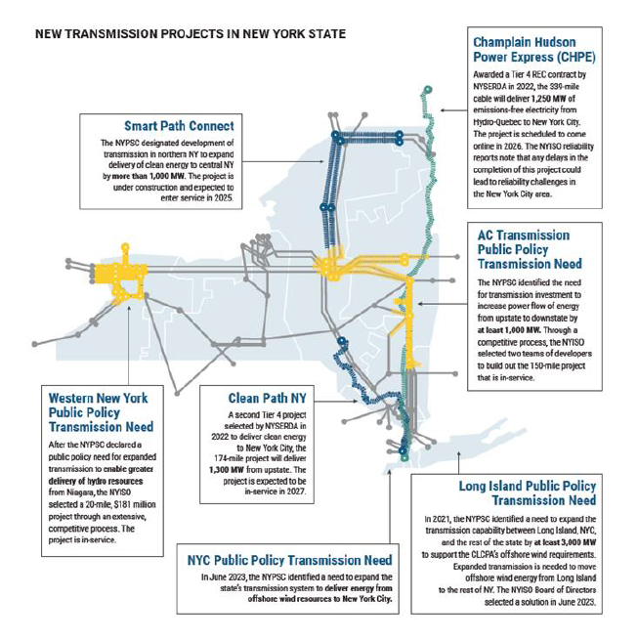
Notes:
This map shows the transmission lines more clearly than the earlier map.

Slide 8
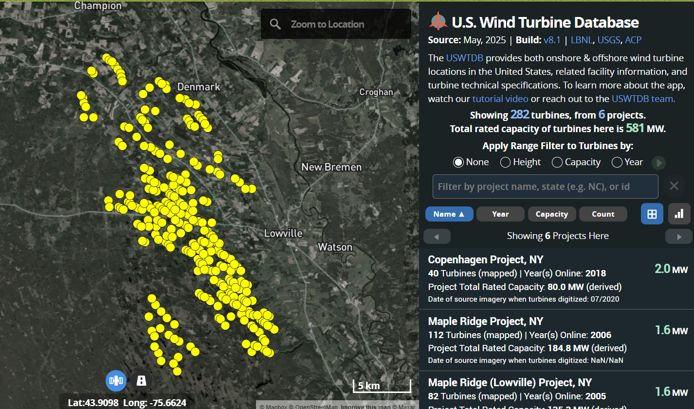
https://energy.usgs.gov/uswtdb/
Notes:
Matt will discuss solar in his section, but I wanted to note here that Lewis County already has many wind farms, which according to the U.S. wind turbine database amounts to 6 projects, 282 turbines, 581MW.

Slide 9
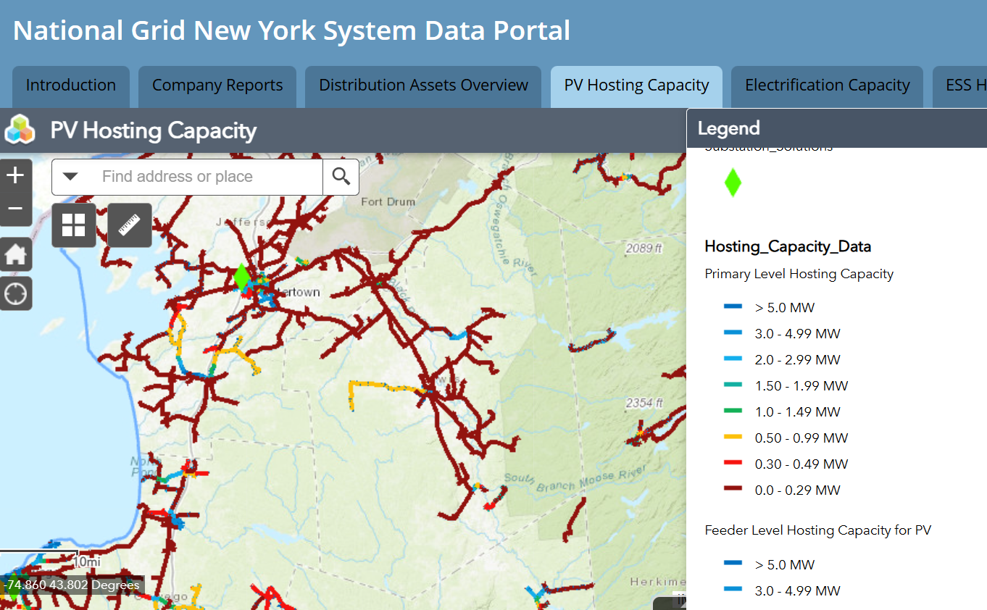
Notes:
Hosting capacity is an estimate of the amount of DER that may be accommodated without adversely impacting power quality or reliability under current configurations and without requiring infrastructure upgrades. This shows that there isn’t a lot of capacity currently.

Slide 10
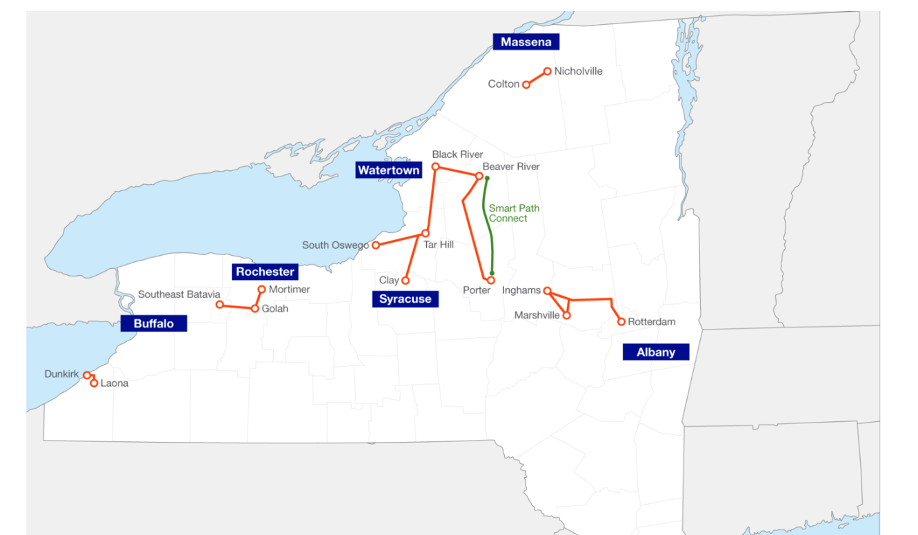
Upstate Upgrade – National Grid
Notes:
Hence the Upstate Upgrade by National Grid, that is currently under construction.

Slide 11
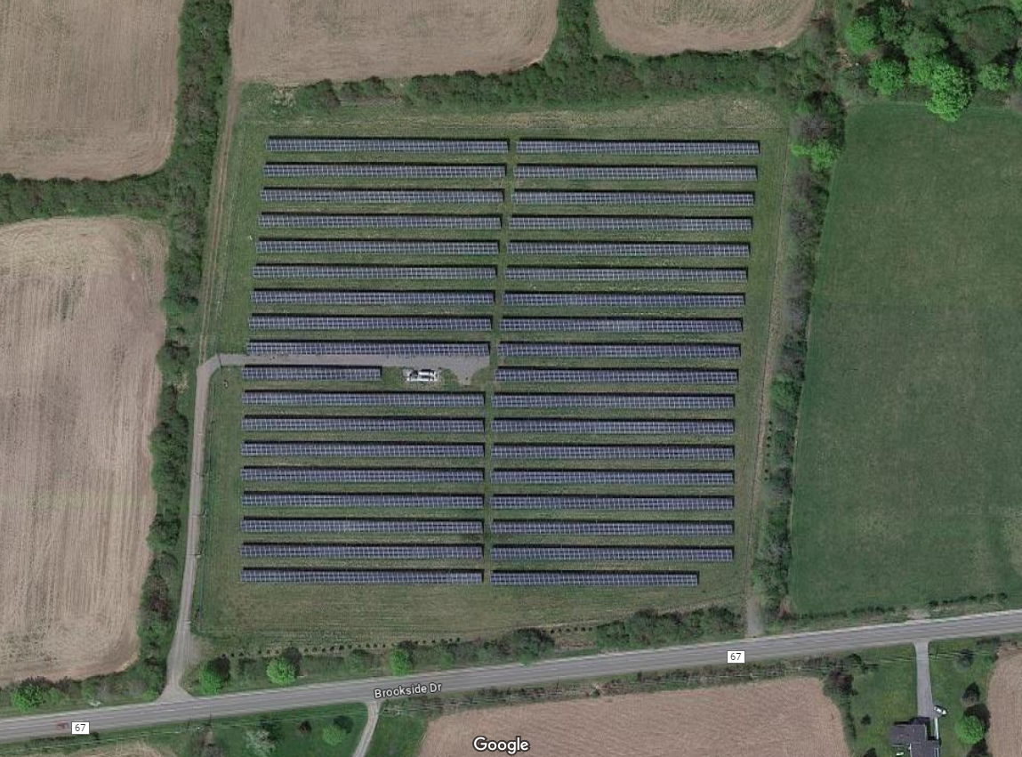
Large Solar Energy Projects
Most impact
on agricultural lands?
Most control by
local governments?

Slide 12
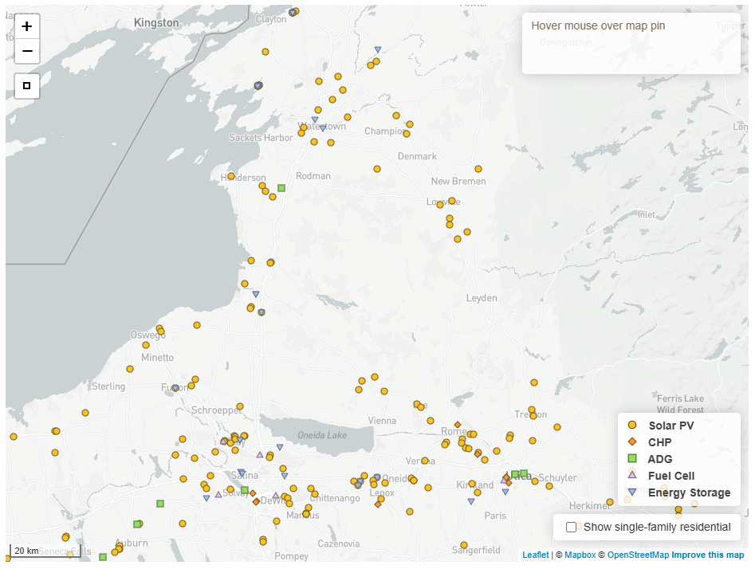
https://der.nyserda.ny.gov/map/
Distributed Solar
https://der.nyserda.ny.gov/map/
Typically 3 - 5 MW
15 - 40 acres
Generate energy on behalf of multiple customers
Local review
der.nyserda.ny.gov/map/

Slide 13
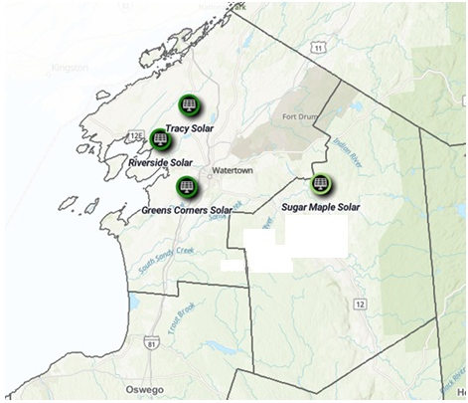
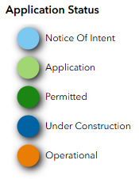
Utility Scale Solar
Typically 100 - 240 MW
1,500 – 1,700 acres
Supply wholesale
energy to the grid
ORES review
125 MW
1,500 ac
20 MW BESS
Google: renewable energy permit status map nyserda

Slide 14
Characteristics of Large Solar
How big? – 5 acres per MW
Where located? – flat, dry, cleared land…
Proximity to transmission lines…
Farm leases - $700 - $2,000/acre
PILOT agreements with municipalities

Slide 15
What Can Municipalities Do To Mitigate?
(projects under 25 MW permitted locally)
MORATORIA
COMPREHENSIVE PLANS
ZONING
  Site plan review
  Special use permit review
Notes:
MJ

Slide 16
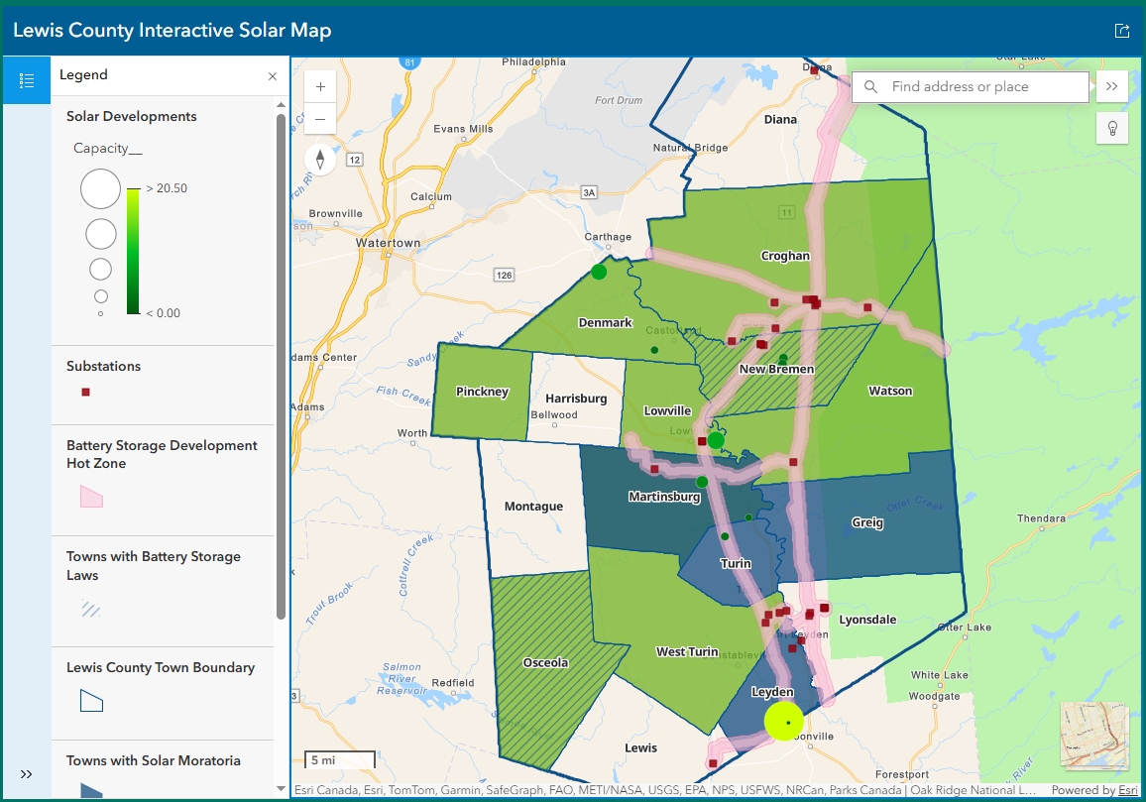
Lewis County Mapper
lewiscountyny.gov/departments/planning-and-community-development/solar/

Slide 17
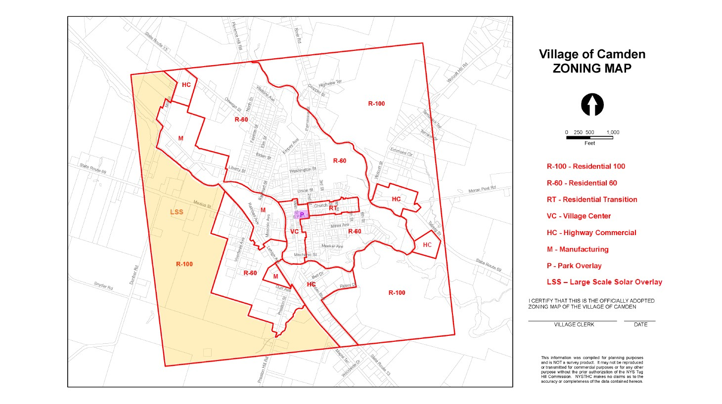
Where Can They Go? – Districts and Overlays
Notes:
MJ

Slide 18
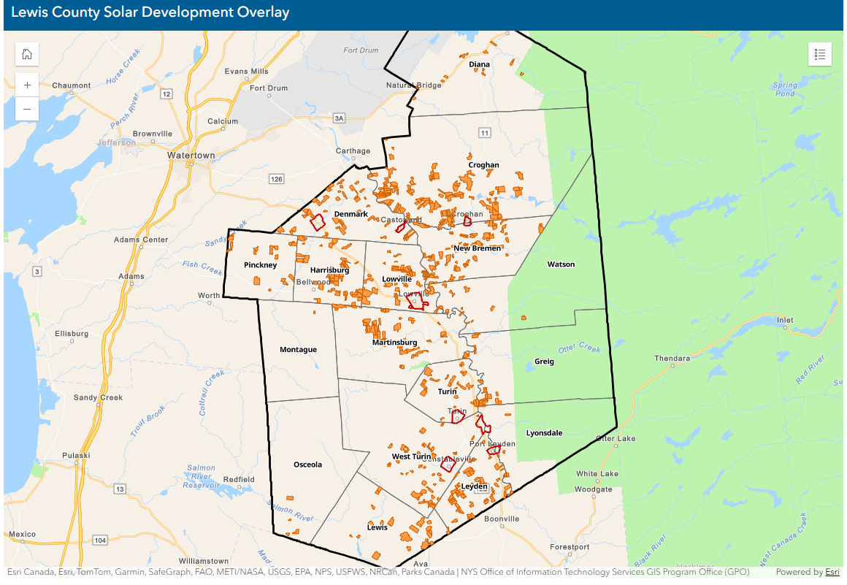
Where Can They Go? – Districts and Overlays
https://lewiscountyny.gov/departments/planning-and-community-development/solar/
Notes:
MJ

Slide 19
Special Use Permit Review by Planning Boards
Required setback and height restrictions
Landscaping and screening requirements
Safety requirements
Visual assessment
Decommissioning plan and site restoration requirements
Cash, bond, or other form of security
Recycling??
Notes:
MJ

Slide 20
Protections For Ag Resources
Solar Energy Systems shall occupy no more than [50] % of the area of MSG 1-4 soils within the Facility Area
Solar Energy Systems may exceed 50% of MSG 1-4 soils if land can still be used as Farm Operation
To the maximum extent practicable, Solar Energy Systems located on MSG 1-4 soils shall be constructed in accordance with the construction requirements of the New York State Department of Agriculture and Markets Guidelines for Solar Energy Projects – Construction Mitigation for Agricultural Lands
Notes:
MJ

Slide 21
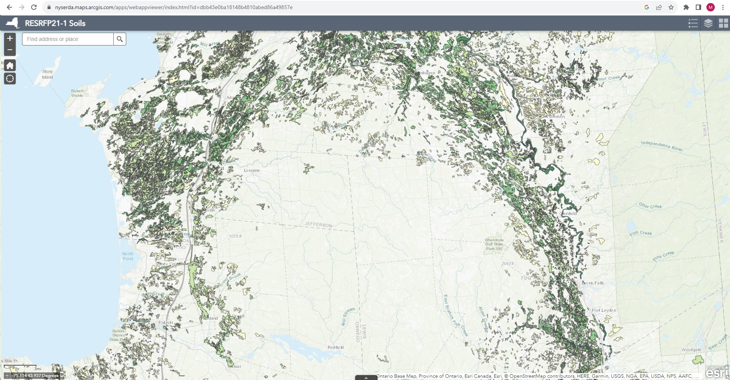
Mineral Soils Groups 1 - 4
Google: nys dept of agriculture and markets soil groups
Also see: https://websoilsurvey.sc.egov.usda.gov/
Notes:
MS

Slide 22
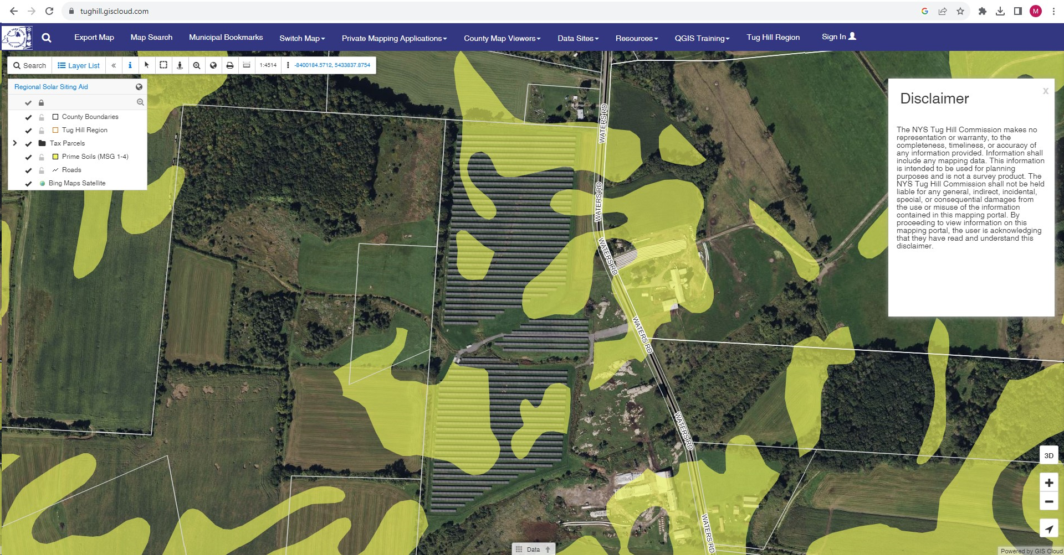
Prime Soils Mapper
www.tughill.giscloud.com
Notes:
MS

Slide 23
Other Levels of Review
County Planning Boards – 239m review
NYS Ag & Markets – consultation for projects in Agricultural Districts
Notes:
MJ

Slide 24
Public Service Law Article 8
Office of Renewable Energy Siting
Projects 25 MW or larger go through a review process overseen by the Office of Renewable Energy Siting (ORES)
Local laws are taken into consideration, but requirements can be waived if found to be unreasonably burdensome to the project
Notes:
MS

Slide 25
Examples of Zoning Waivers Granted by ORES
Decommissioning bonds that have an annual inflation escalator built in
Some noise limits
Some requirements for permeable access roads (i.e. no pavement)
Prohibition of siting on any amount of prime farmland
Requirements that components below 4 feet be removed
Large setbacks from wetlands
500-foot setbacks from property lines
40% maximum lot coverage
15% of lot maximum vegetation clearing
Notes:
MJ

Slide 26
Other Policies/Initiatives to Preserve Ag Land
Smart Solar Siting Scorecard – used to evaluate utility scale projects for avoidance and mitigation of ag and forest land
Lewis County IDA PILOT structure:
• Incentivizing solar development on land that is not active farmland.
• In cases where solar is proposed on active farmland, incentivizing the development on land which is not “prime” farmland, or “Prime – If drained” farmland.
BUILD READY PROGRAM
Notes:
MJ

Slide 27
NYSERDA Build Ready Program
Sites typically 50+ acres located in areas where the existing electrical grid has capacity for a new project.
Build-Ready gives priority to:
■ Former industrial or commercial sites
■ Closed landfills
■ Brownfield sites
■ Dormant electric generating sites
■ Underutilized, abandoned, and vacant sites
■ Other previously developed sites
Notes:
MJ

Slide 28
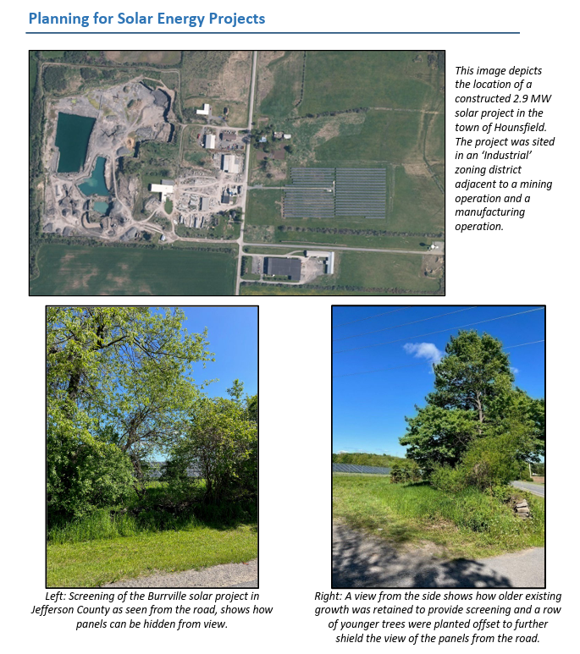
Notes:
MJ

Slide 29
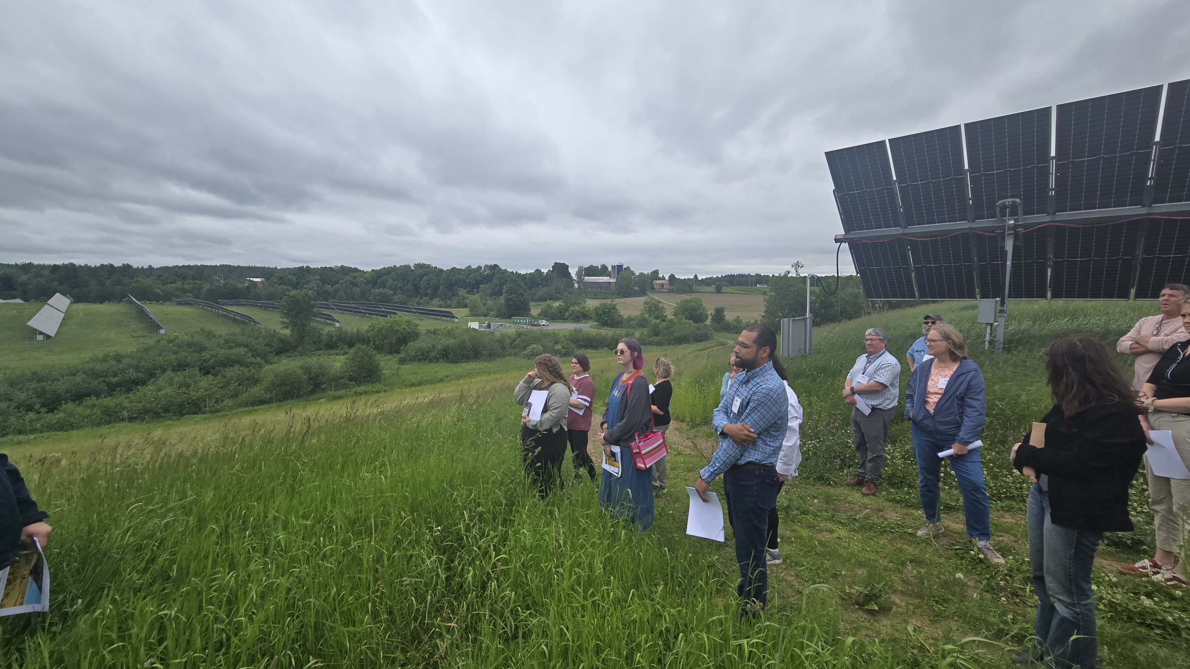
Agrivoltaics
Tug Hill Commission and American Farmland Trust did four roundtables and a wrap up presentation earlier this year
Still in its infancy
Local example – ClearPath Energy in New Bremen, 50 acres, 4.5 MW, allows haying for beef cattle operation; 64 foot spacing, 8 feet to racking, single axis tracker system
Notes:
MJ
Current Ag & Markets agrivoltaics definition: the simultaneous use of land for solar photovoltaic power generation and agricultural production of “crops, livestock and livestock products,” as defined by NYS Agriculture and Markets Law (AML) Sec 310(2).
Keeps land in ag production
Contributes to renewable energy goals
Dedicated income stream from solar lease
Help facilitate transfer to the next generation of farmers
Can provide access to farmland

Slide 30
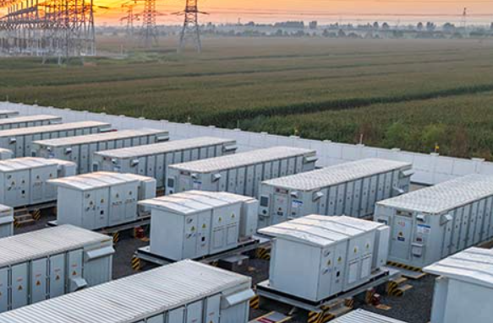
Battery Energy Storage Systems (BESS)
Electricity is stored and held until it’s needed, such as during peak usage times, grid disturbances, or outages.
Local governments can review through zoning and require safety elements and training (if not associated with ORES review).
Sugar Maple project in Lewis County has 20 MW of storage planned.
Notes:
MJ

Slide 31
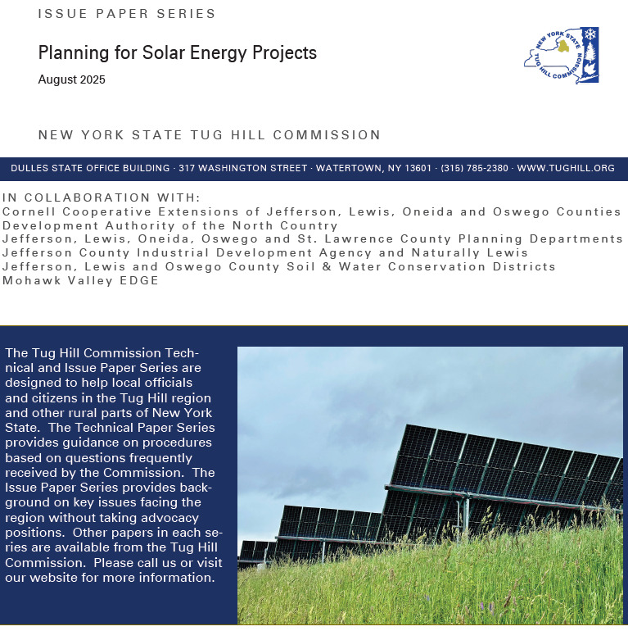
Questions?
www.tughill.org
katie@tughill.org
matt@tughill.org
Notes:
Released in June.

