Slide 1
Ecological Monitoring Surrounding Barrier Sites in the Village of Mexico
Jeremy Dietrich
Principal Aquatic Ecologist
NYS Water Resources Institute
Cornell University
August 28, 2024

Slide 2
Monitoring Locations
2022 - 2024
Awes Mill Dam
Little Salmon Dam
Youngs Mill (Black Creek) Dam

Slide 3
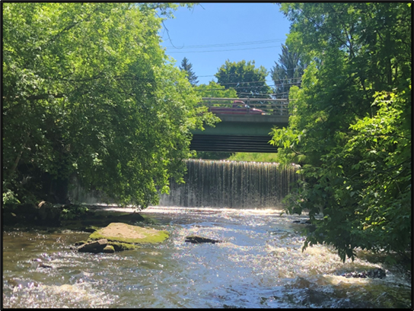
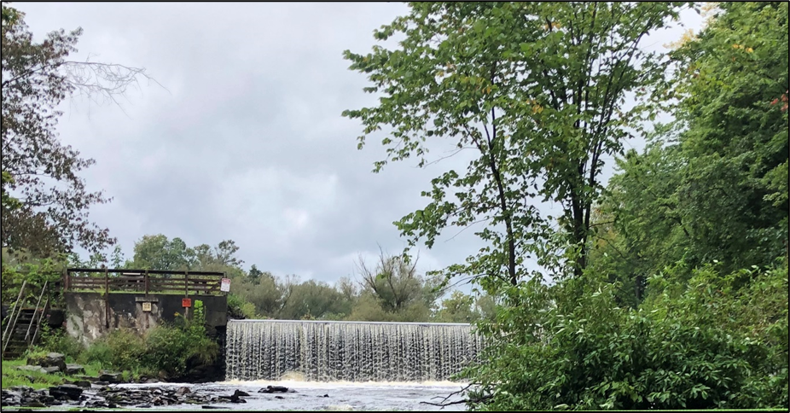
YOUNGS MILL DAM
(2022-2023-2024)
AWES MILL DAM
(2023-2024)
LITTLE SALMON DAM
(2022-2023)

Slide 4
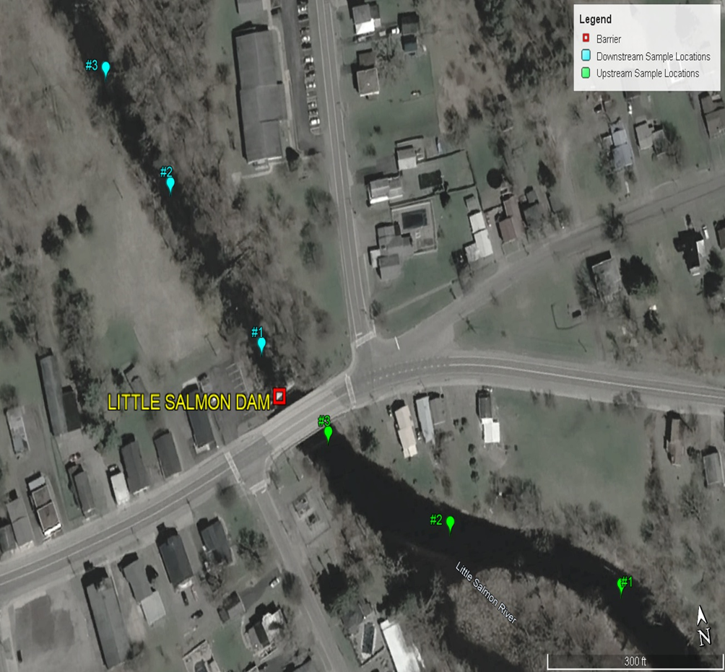
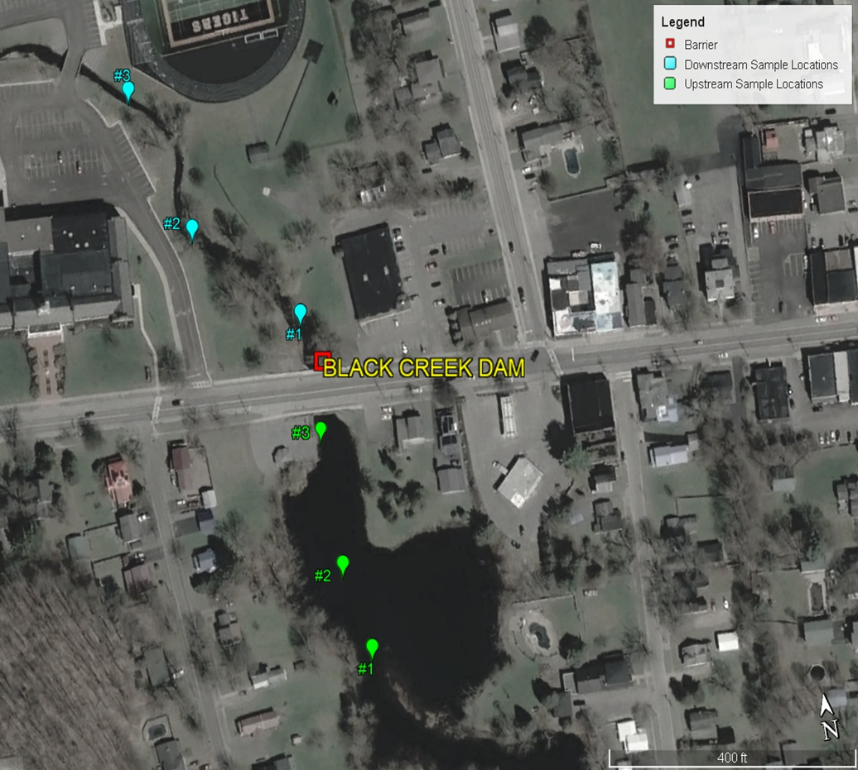
Field Sampling Locations / Transects
Paired upstream-downstream sampling sites.

Slide 5
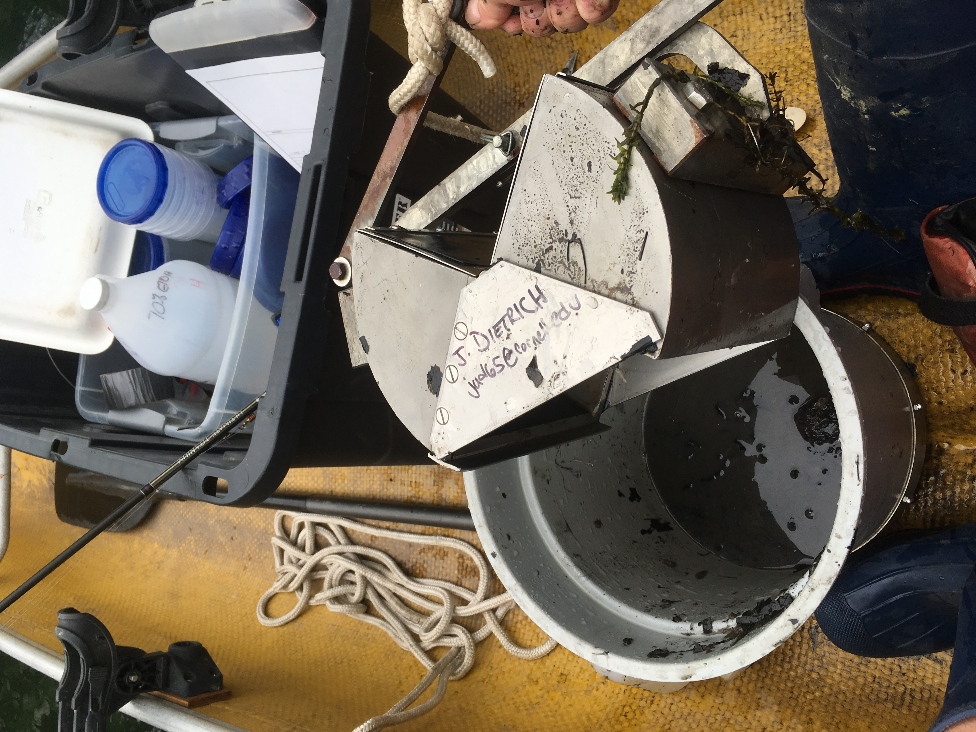
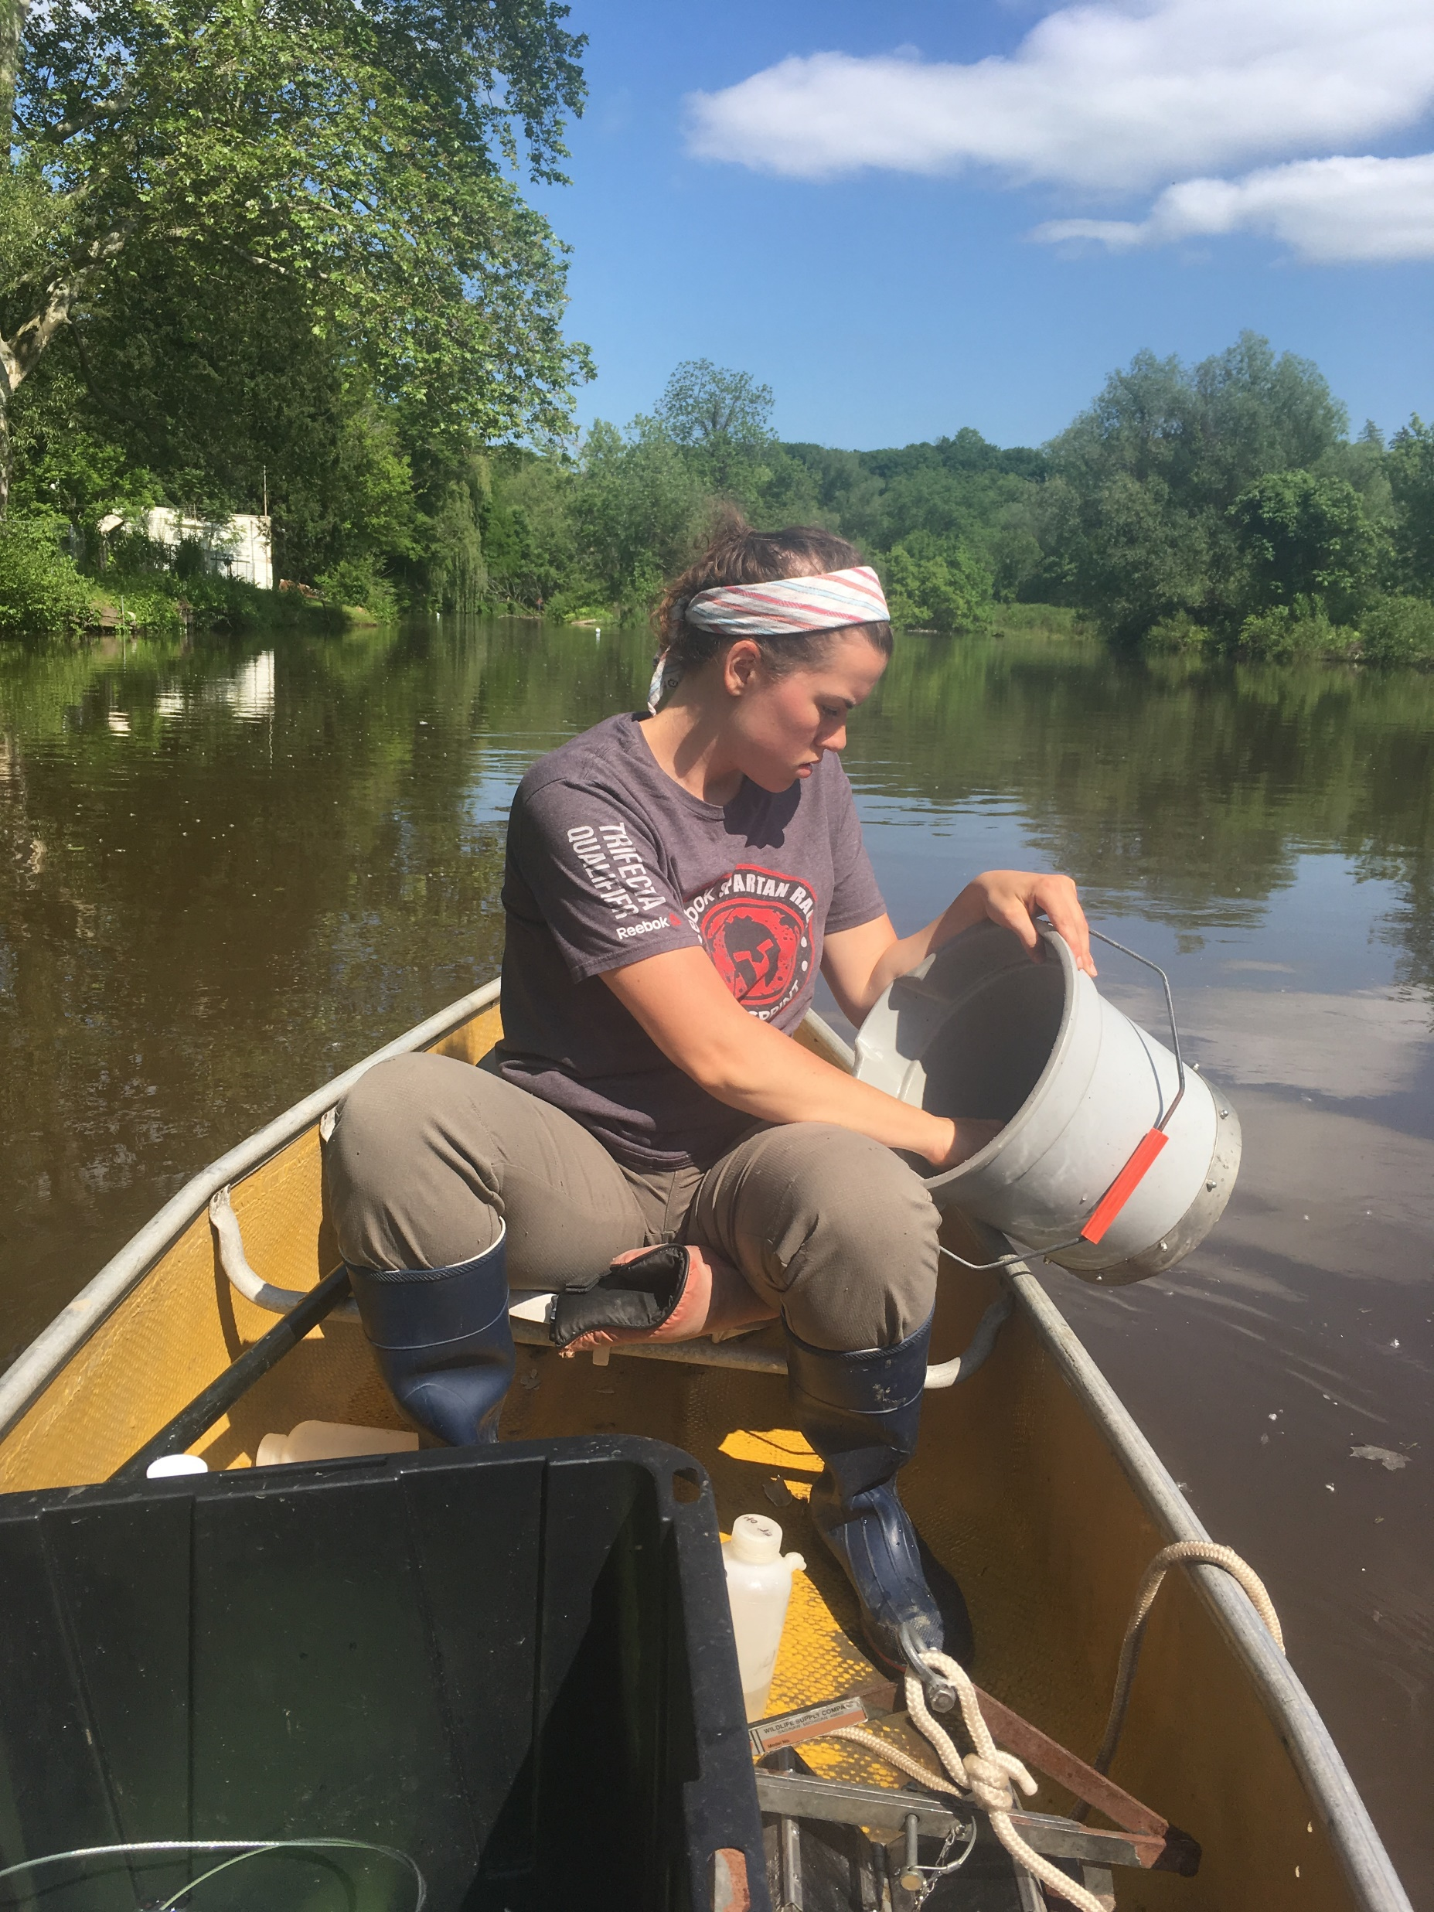
Field Collections: Upstream Ponar Dredge
Capturing benthic organisms.

Slide 6
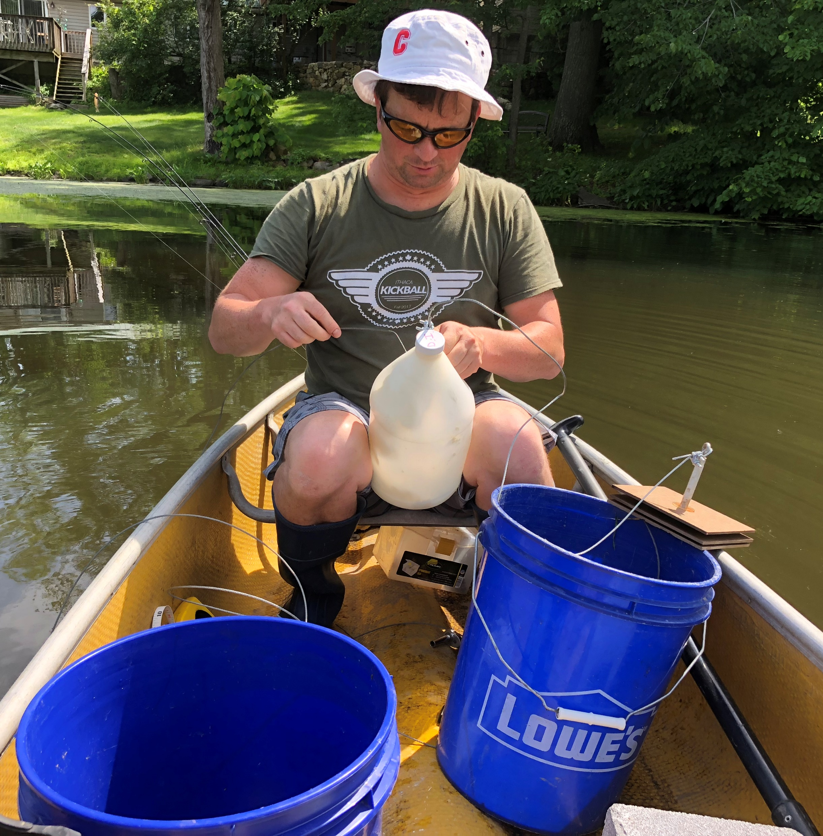
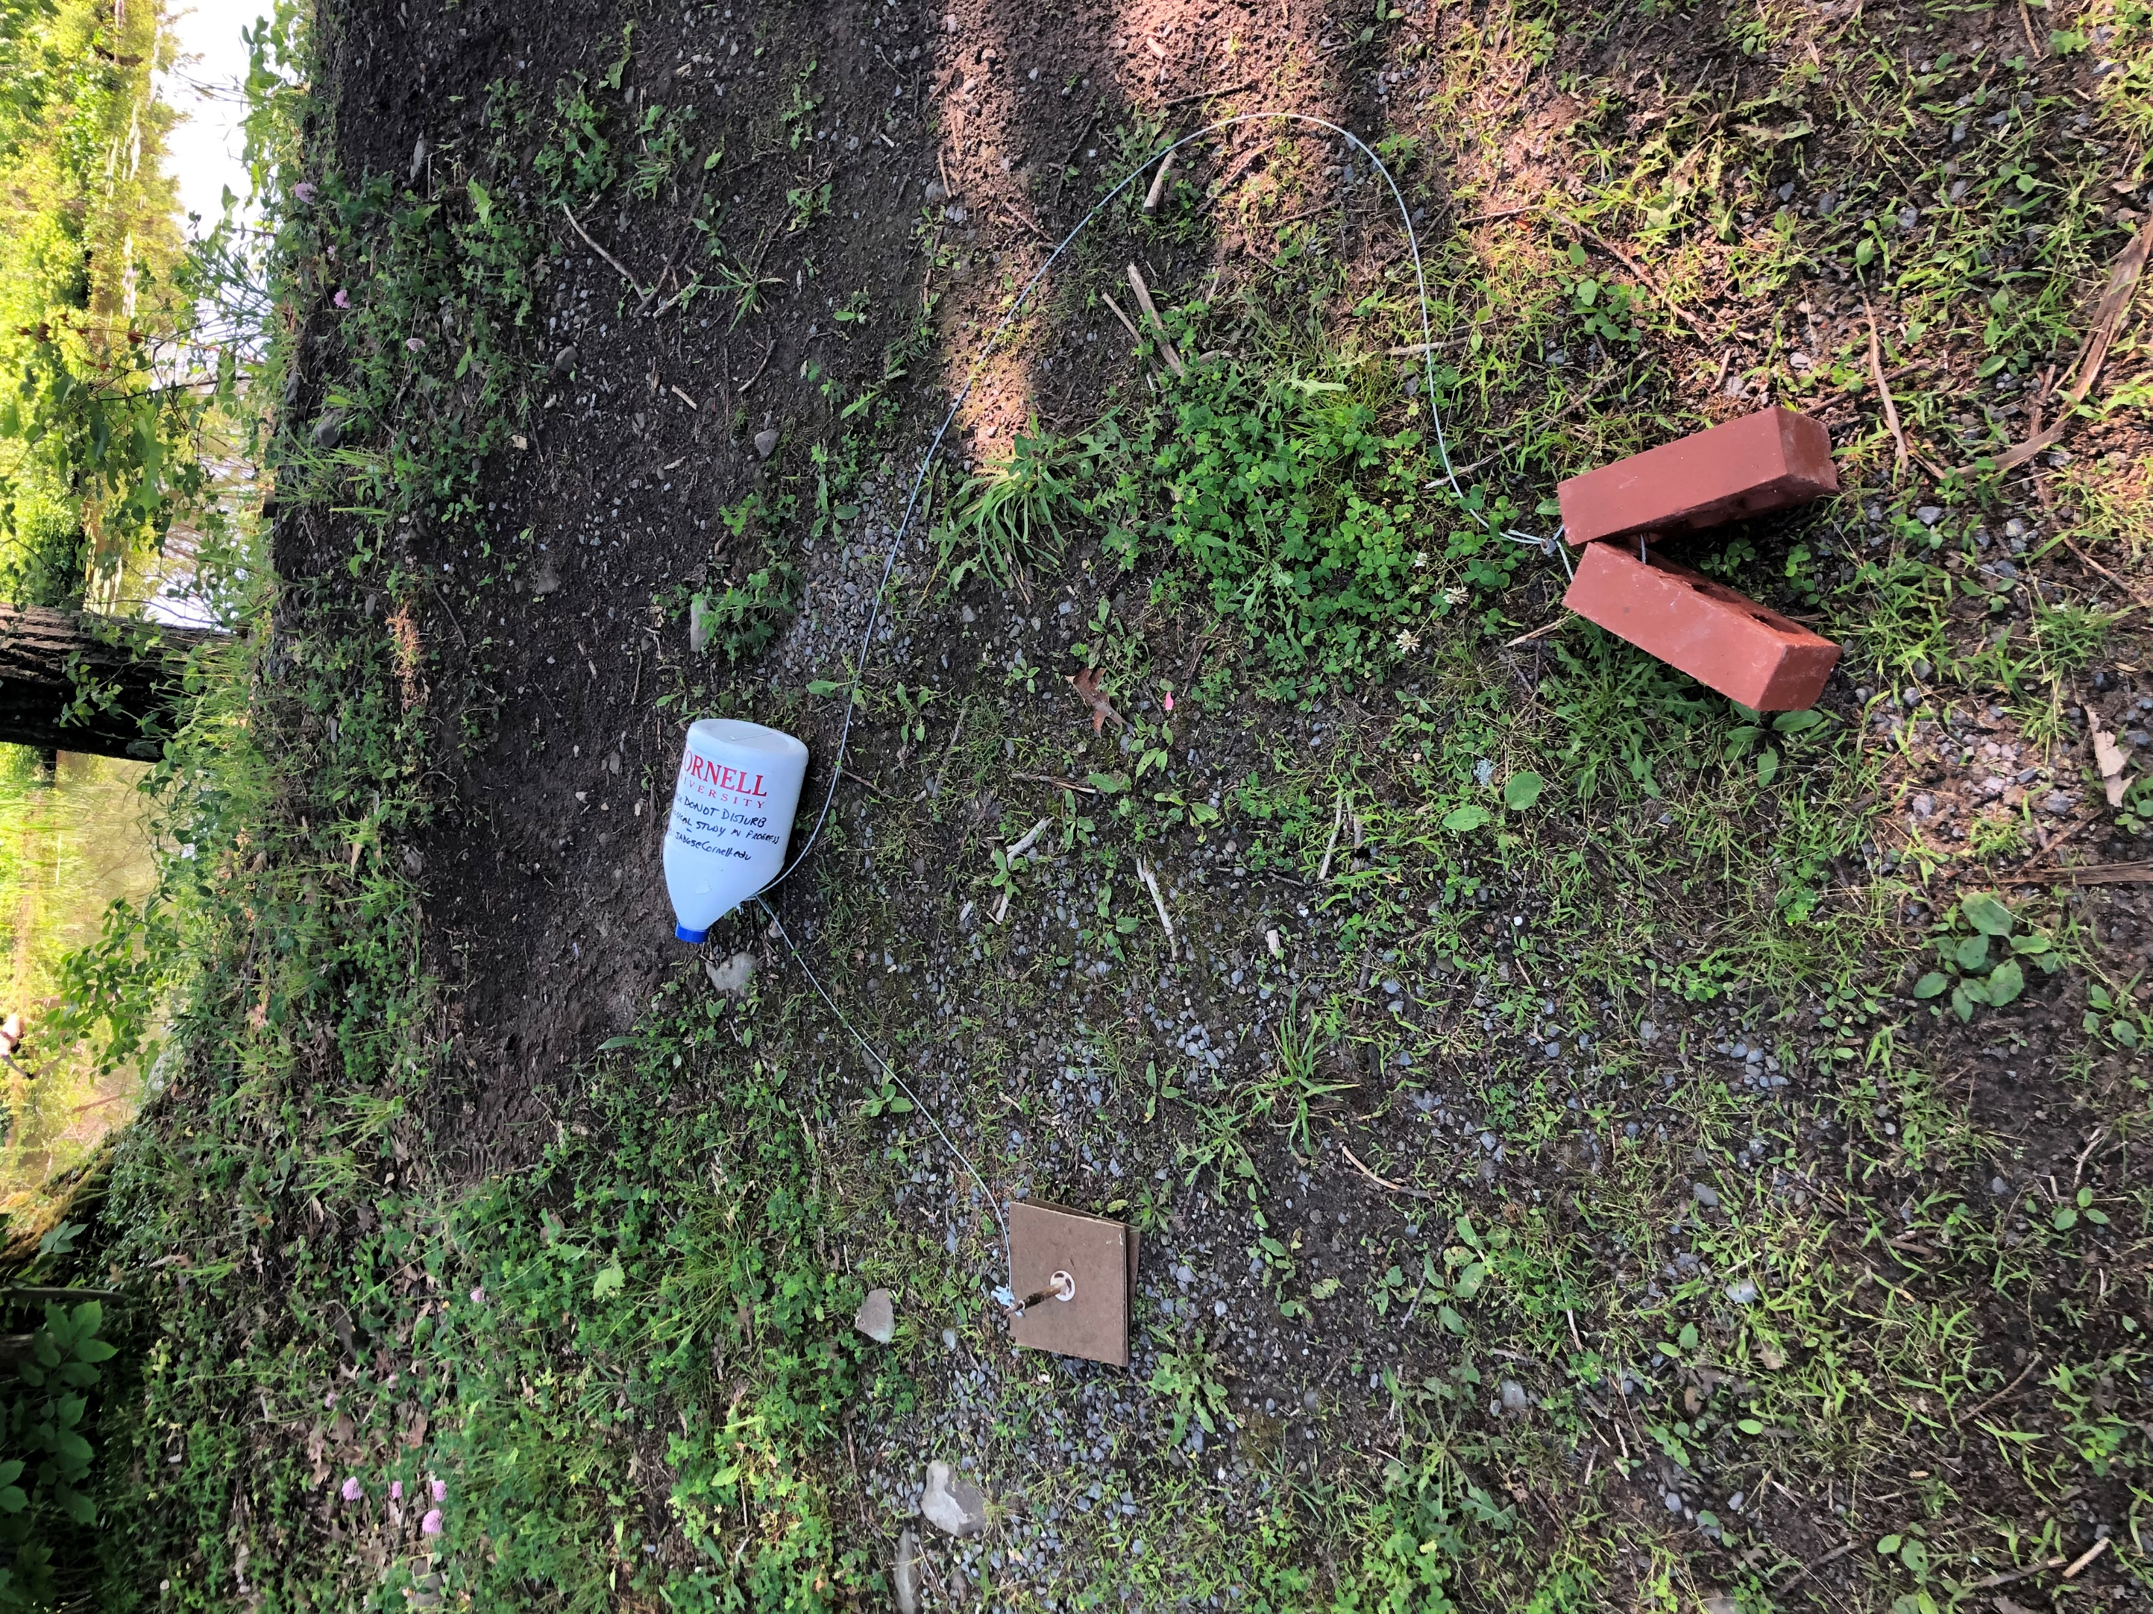
Field Collections Upstream: Multi-Plate Sample
Capturing organisms in drift and within water column.

Slide 7
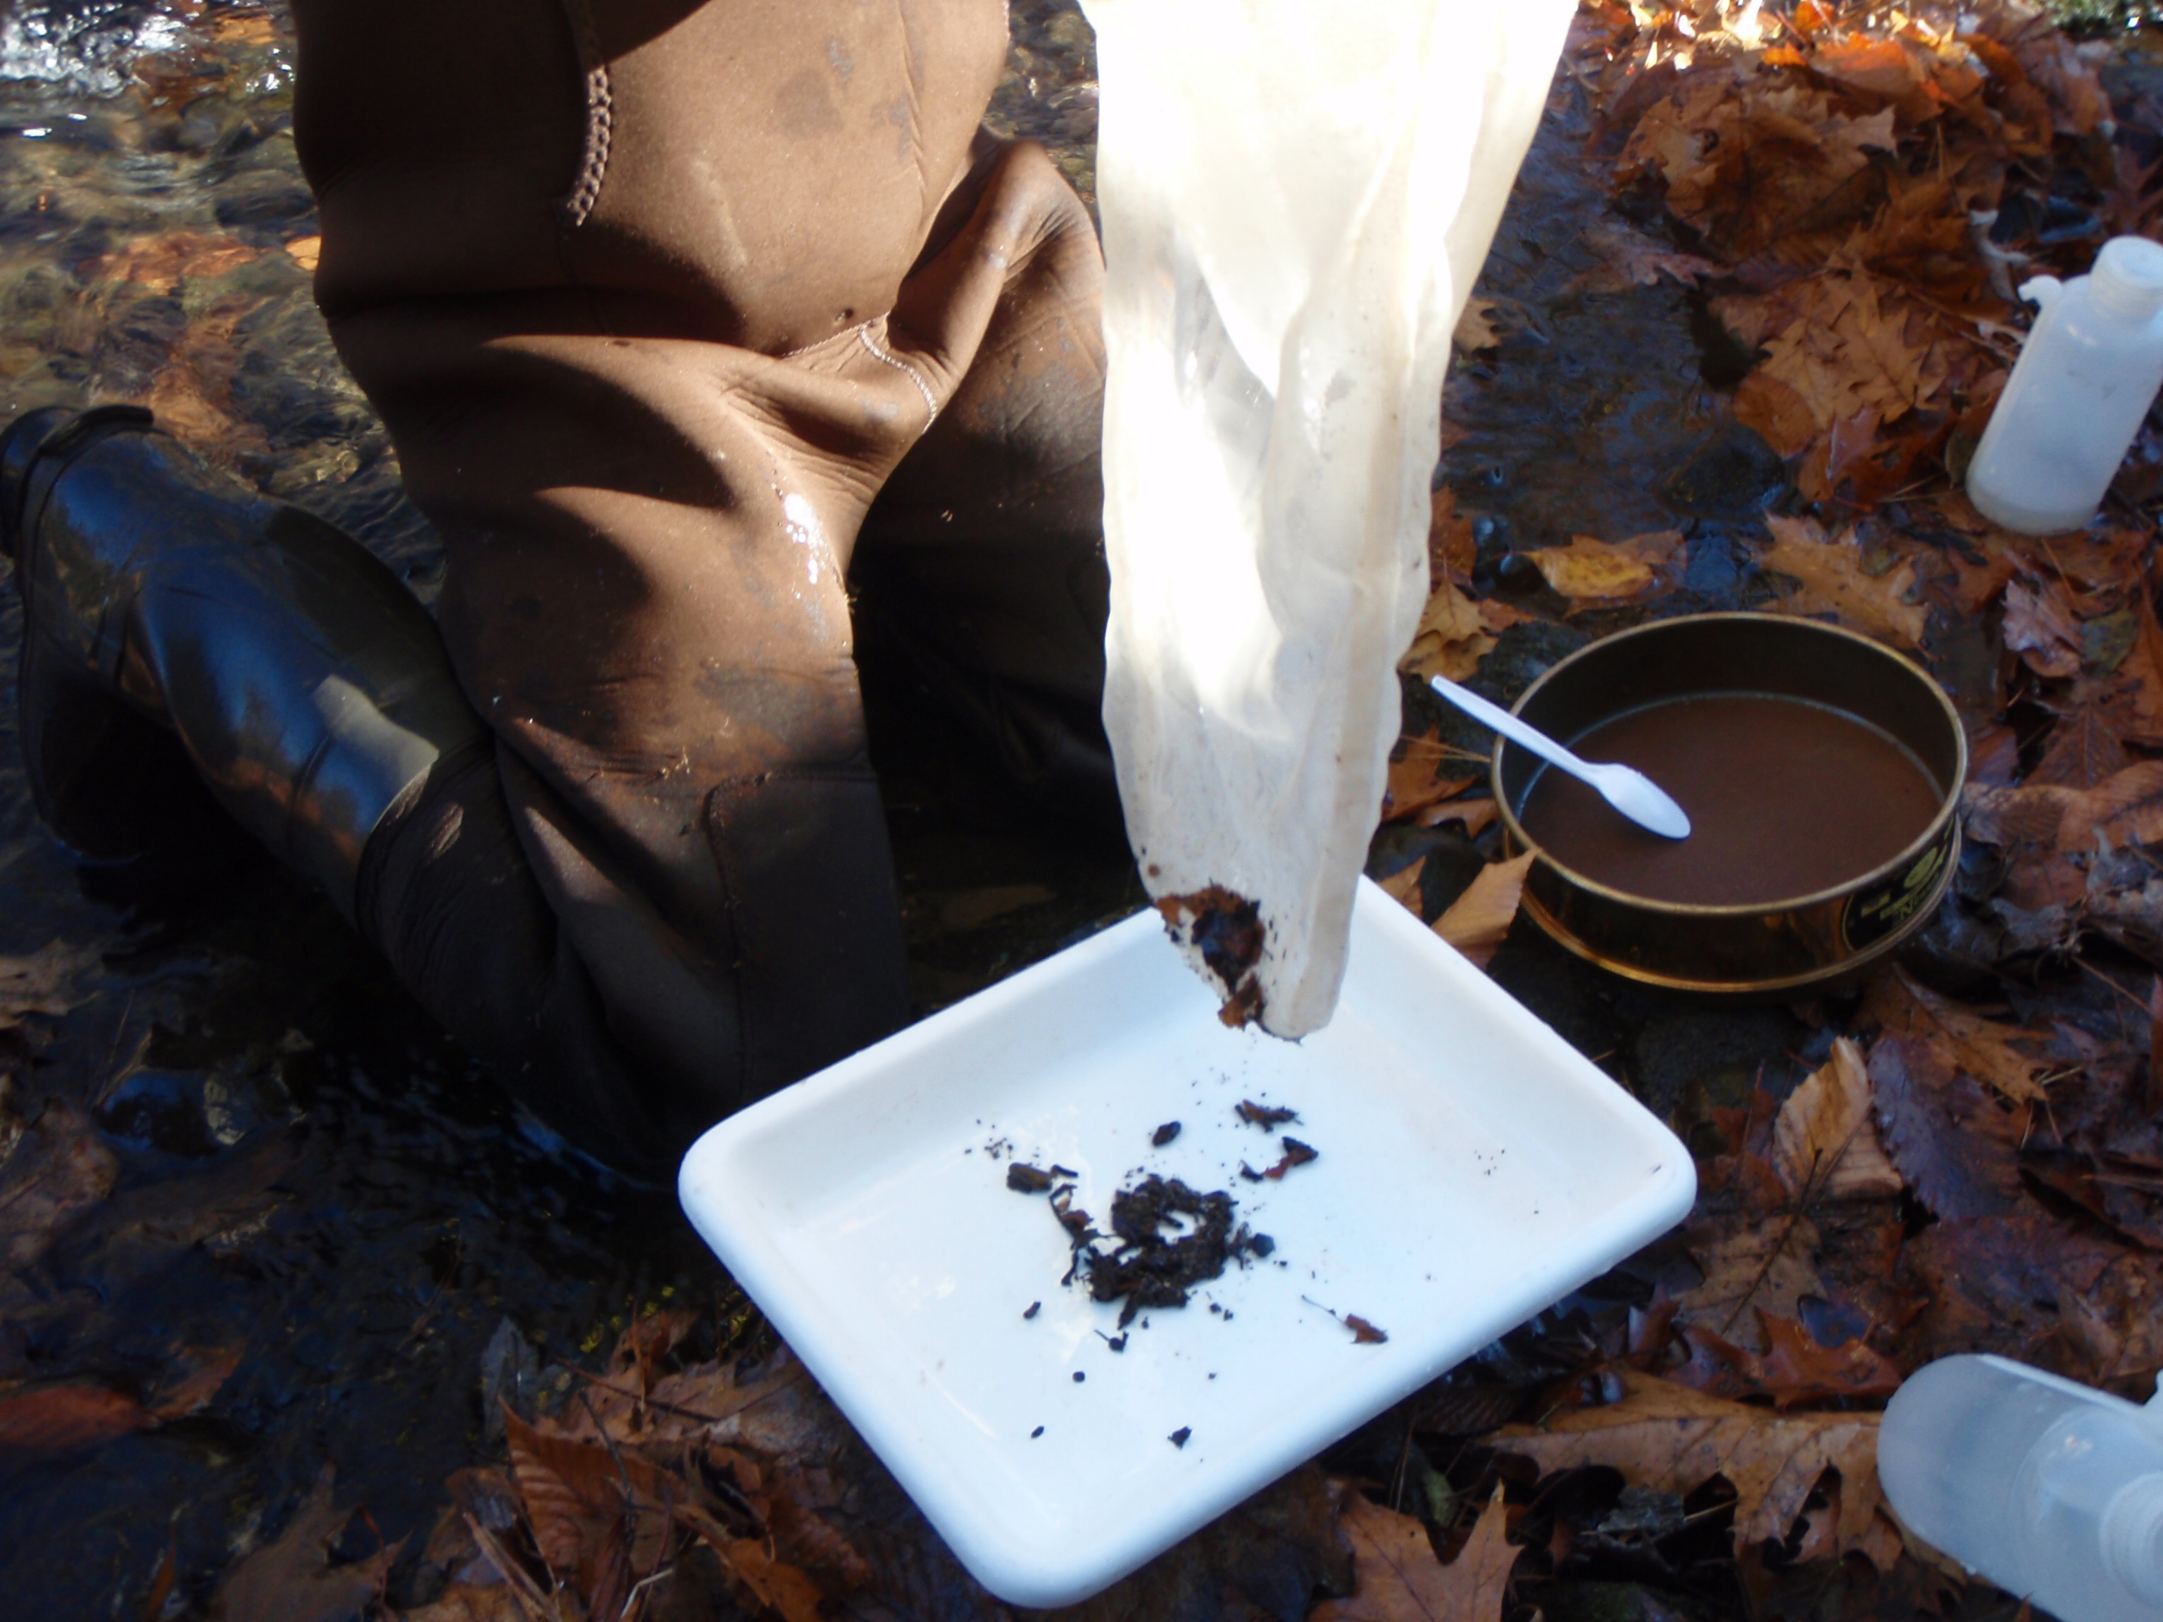
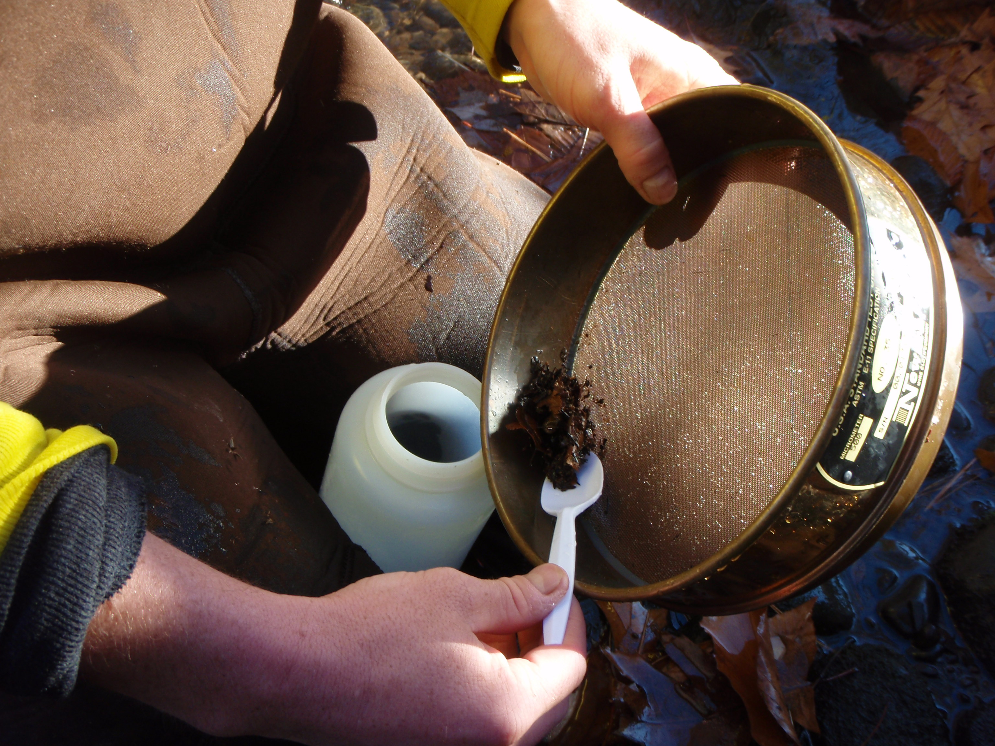
Field Collections: Downstream Kick-Sample
Captures both benthic and drift organisms.

Slide 8
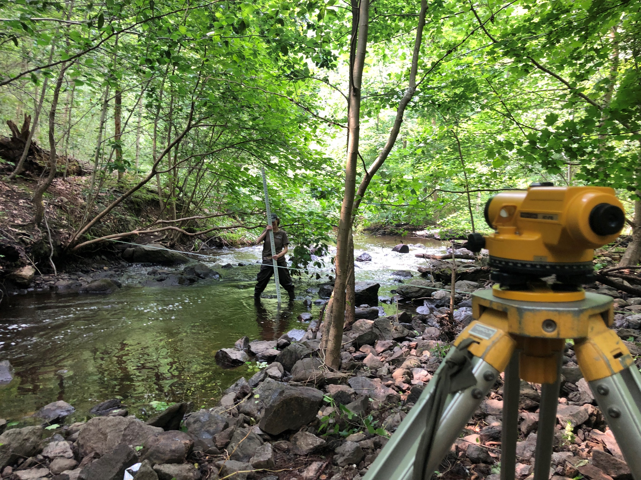
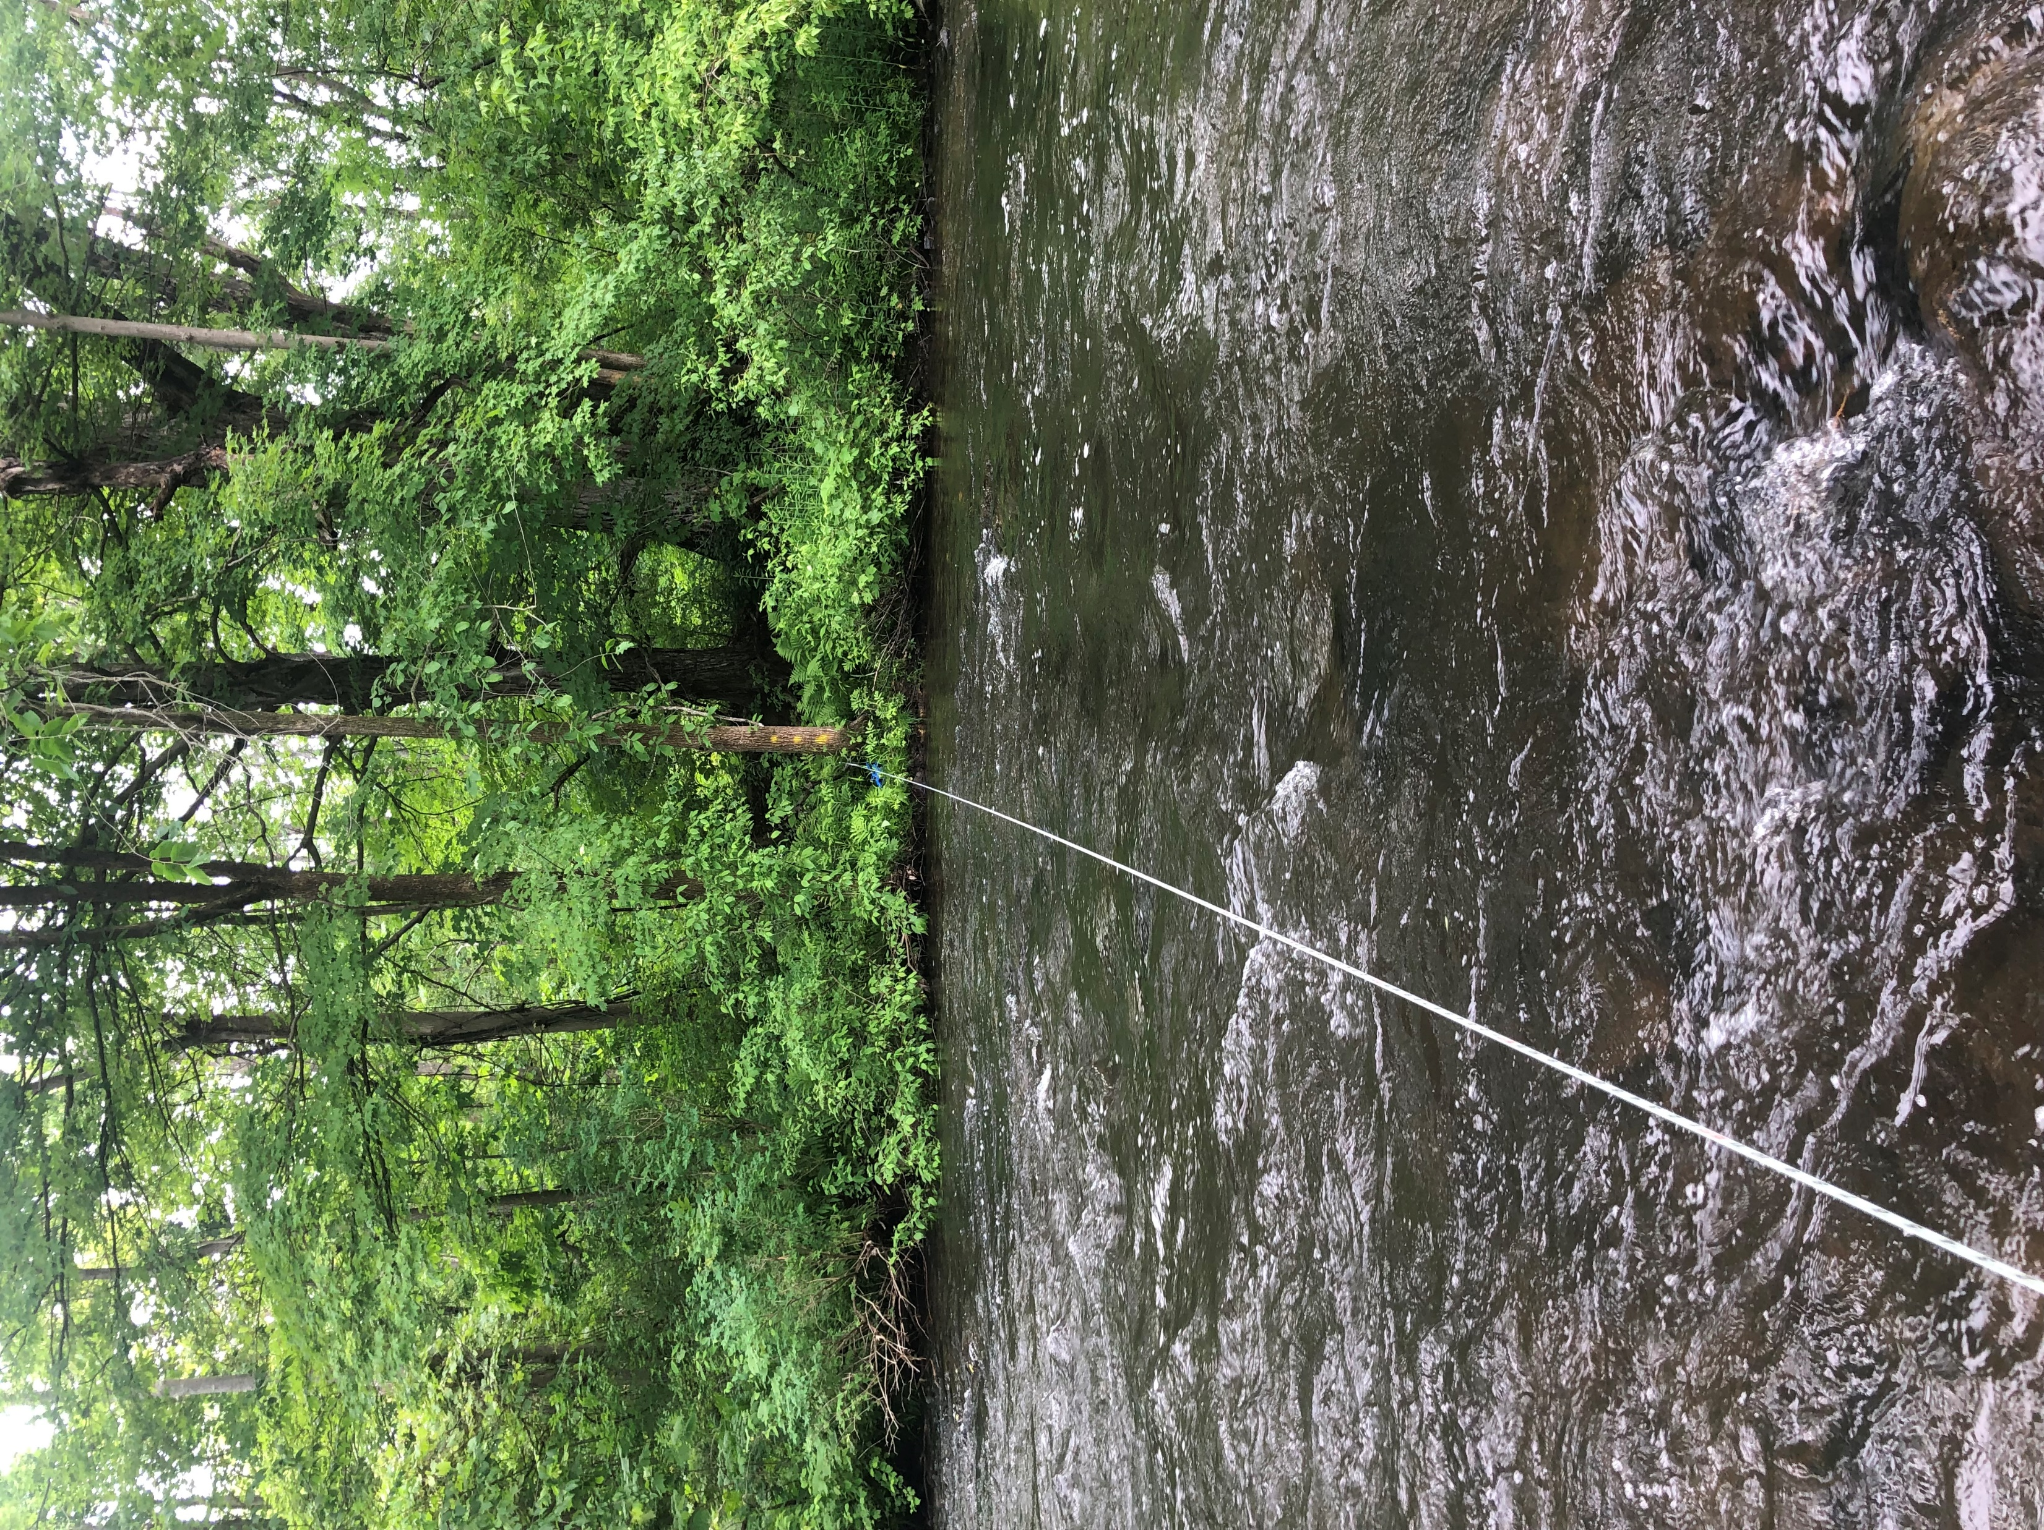
Transect Substrate and Channel Survey
Recording instream substrate type and channel elevation at every 1-ft; each end of transect is fixed with steel spike.

Slide 9
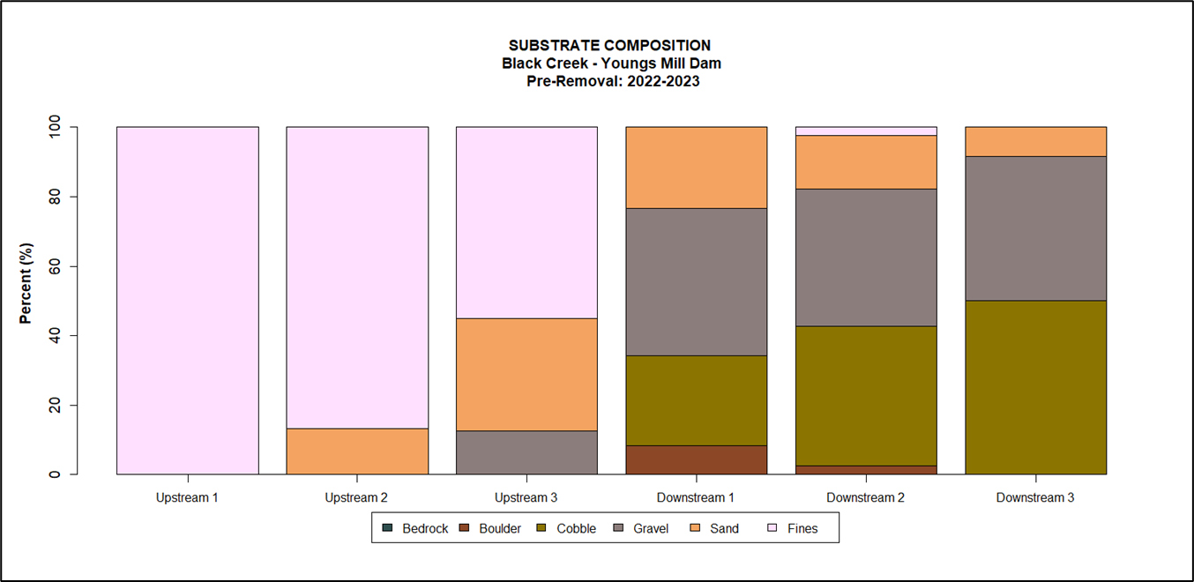
Substrate & Instream Habitat Pre-Removal Conditions
All locations display benthic habitat disparities between the upstream impoundment and downstream tail reach.
Upstream sediment composition within the impoundment on Black Creek, averages 78% silt/clay, 17% sand, and 5% gravel.
Downstream of the Black Creek Dam, the sediment composition is more varied and consists of 4% boulder, 38% cobble, 41% gravel, 16% sand, and 1% silt/clay.
Habitat variability important for maximizing biological diversity.

Slide 10
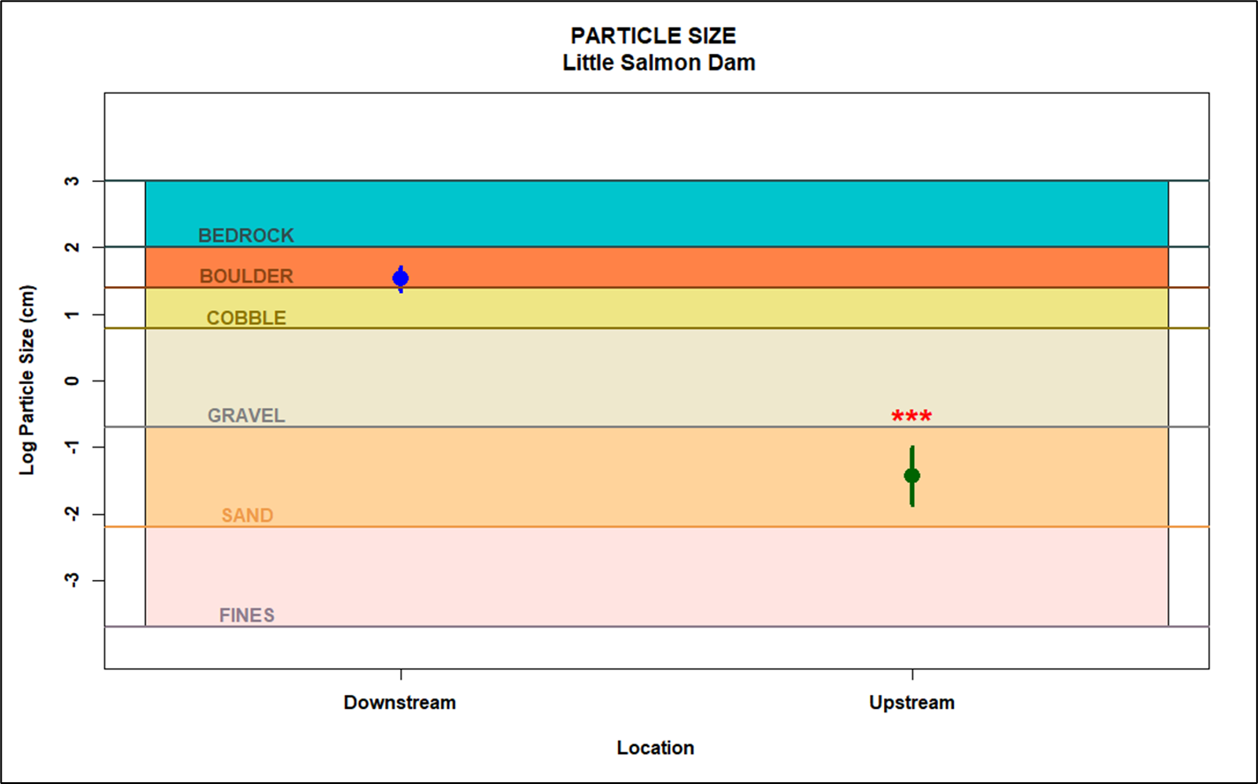
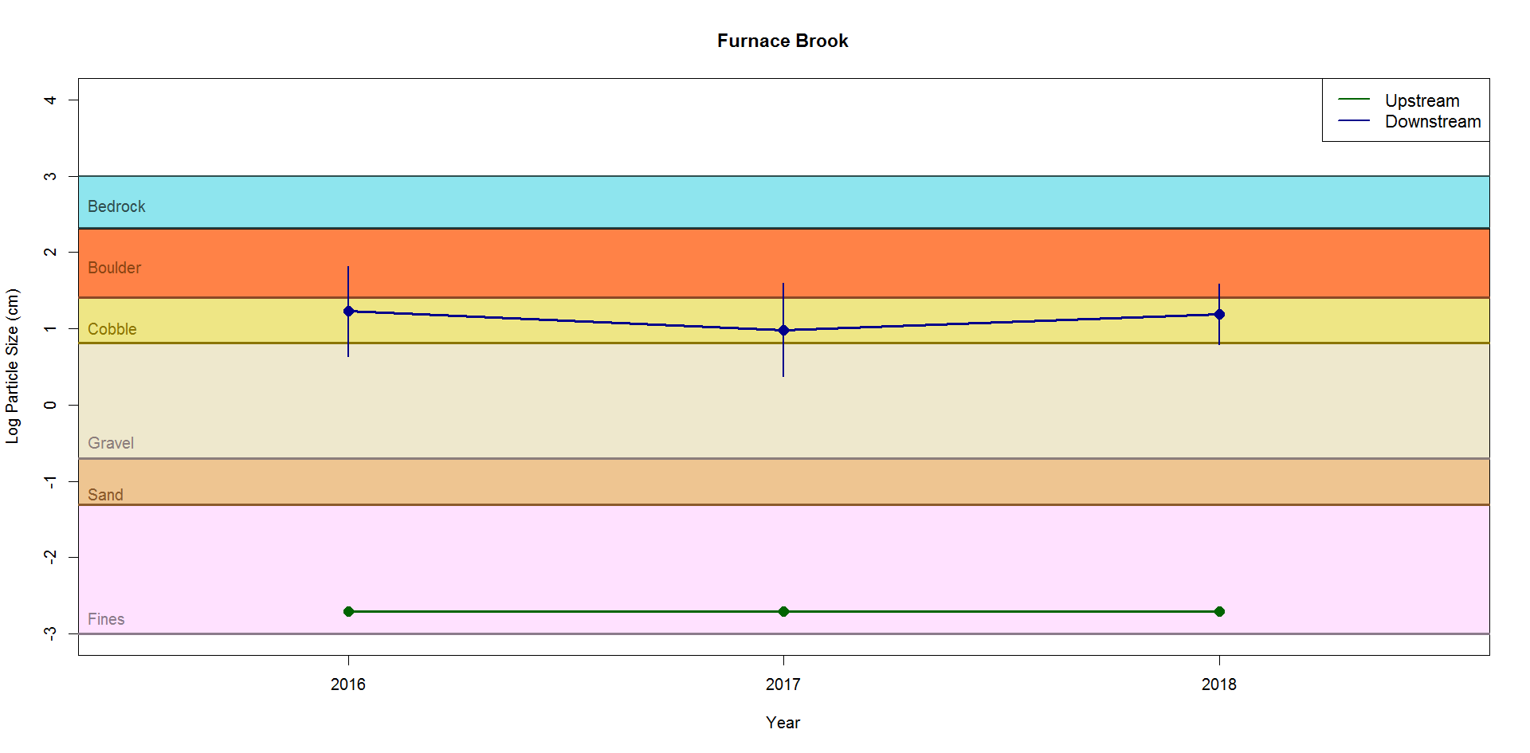
Quantitative Sediment Particle Size Trends
Upstream impoundment areas possess significantly
lower particle size (0.07cm) than downstream reaches (37cm).
Barriers cause static habitat conditions due to the interruption of hydraulic forces and sediment transport.

Slide 11
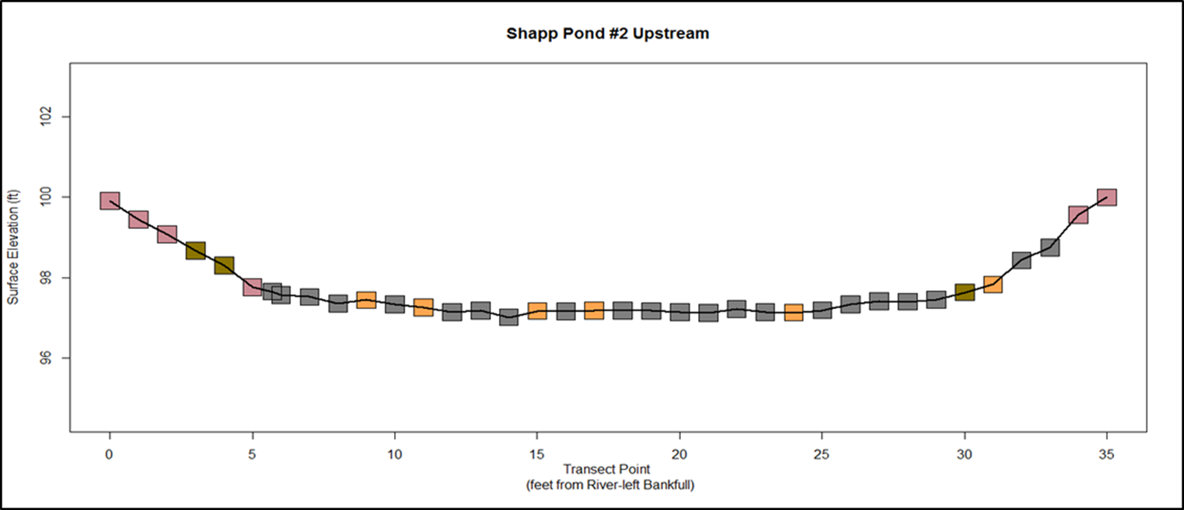
Channel Morphology Transect Surveys
Provide an elevational cross-section of the channel.
Illustrate the distribution of different sediment types across the channel.
Can track changes in channel morphology (erosion/deposition) and sediment distribution following dam removal.

Slide 12
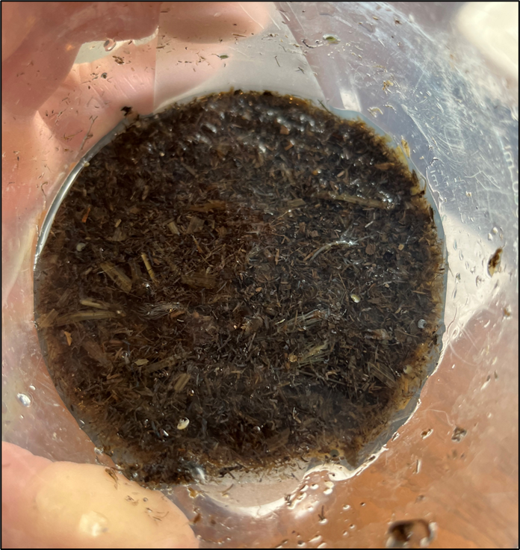
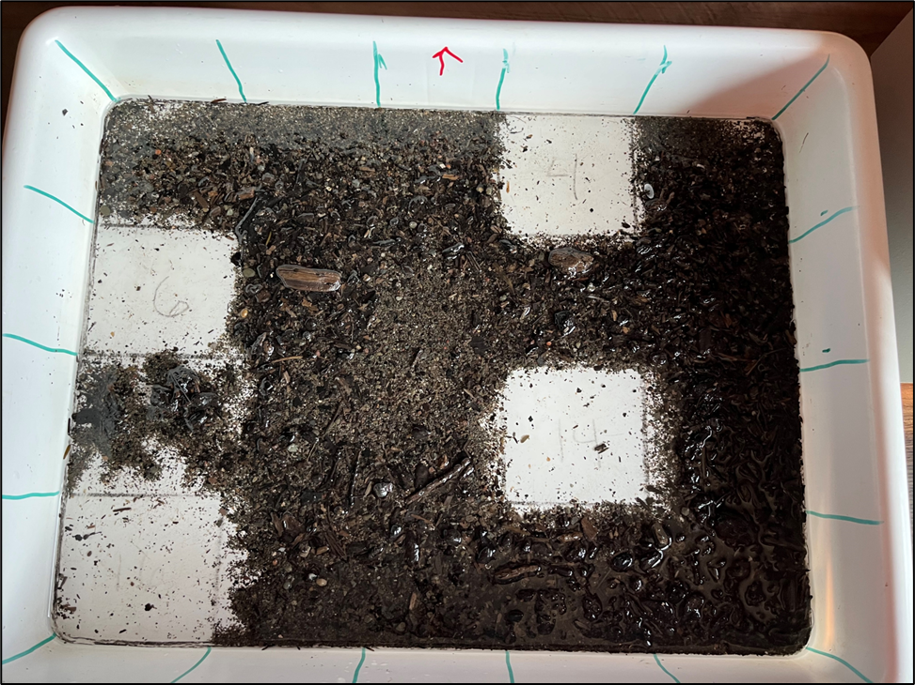
In The Lab: Macroinvertebrate Processing
Evenly distributed in sorting pan, grids picked randomly to achieve min. 100 sub-sample count.
‘Raw’ sample collected from field site.

Slide 13
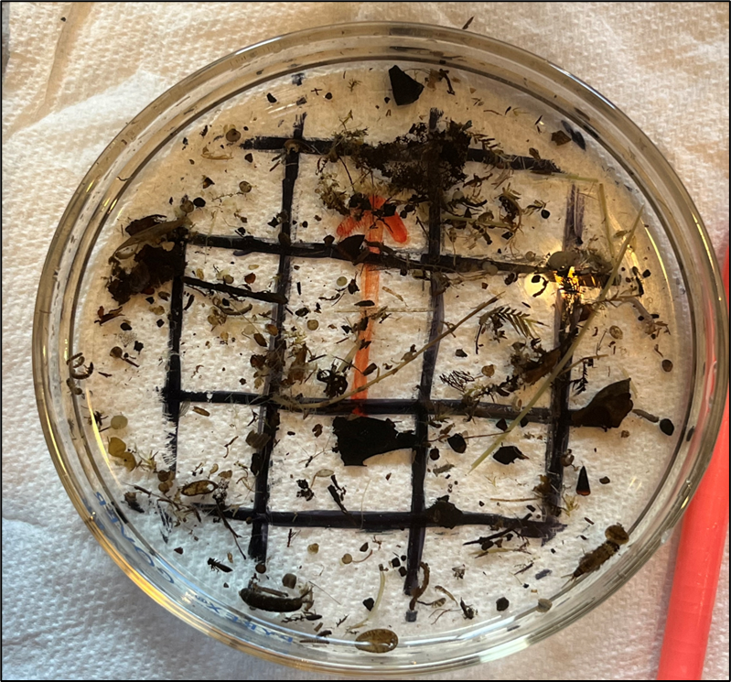
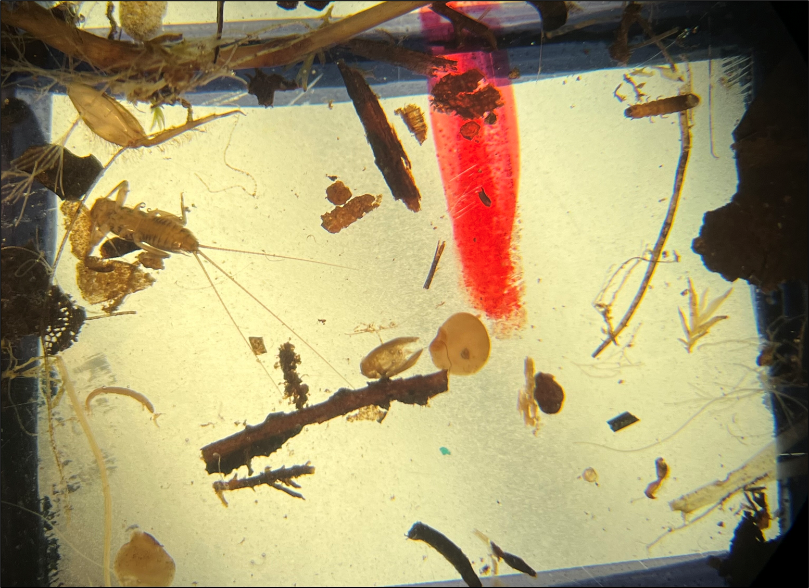
In The Lab: Picking Macroinvertebrate Sub-Sample
Raw sample grid contents placed into petri dish for inspection.
Under microscope (40x), macroinvertebrates are picked out of raw sample for ID and enumeration.

Slide 14
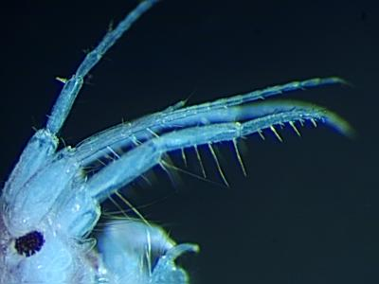
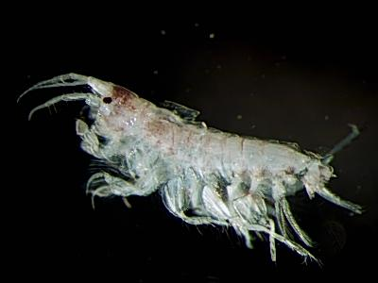
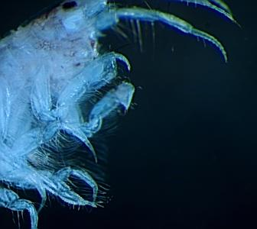
In The Lab: Macroinverterate Identification
accessory flagella
Telson is rounded and entire.
uropods 3
gnathopod 1
(***Example slide…taxa not represented in all areas***)
Leptocheirus plumulosus is a common burrowing Aorid amphipod found in estuarine areas. Like all Aoridae, L. plumulosus has an accessory flagella, biramous uropods 3, and an entire telson.
gnathopod 2
Uropods 3 are short and biramous.
Gnathopods 1 larger than gnathopods 2.

Slide 15
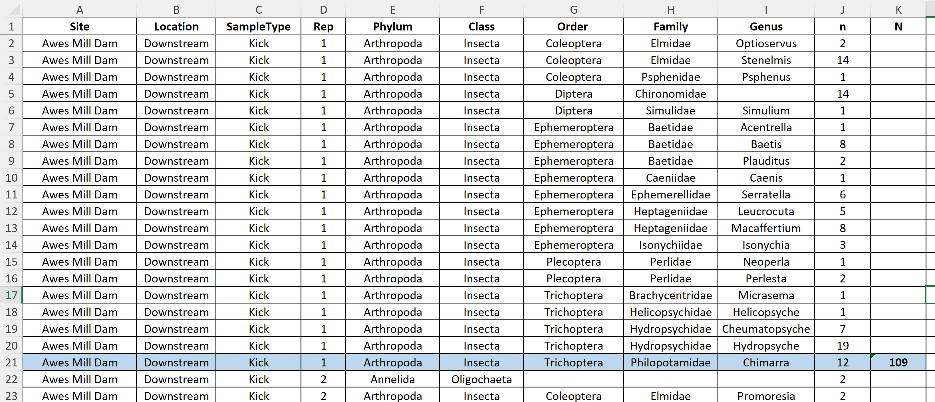
Data Analysis: Recording Taxa Information
Documenting abundance and diversity of existing macroinvertebrate population.

Slide 16
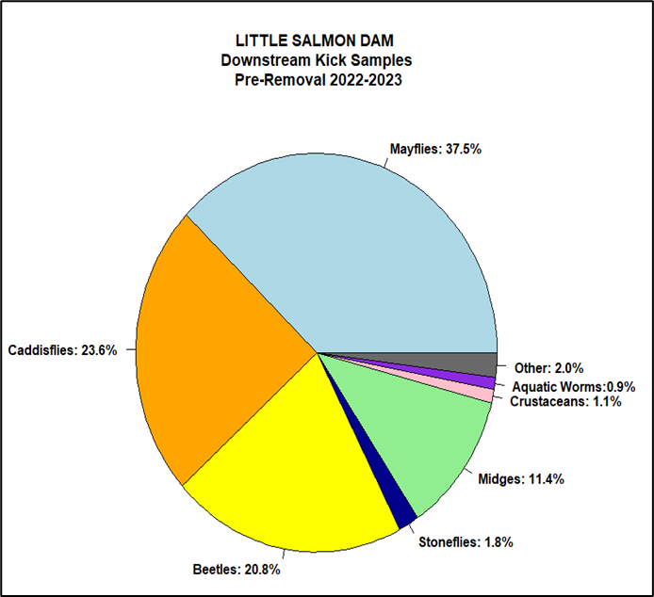
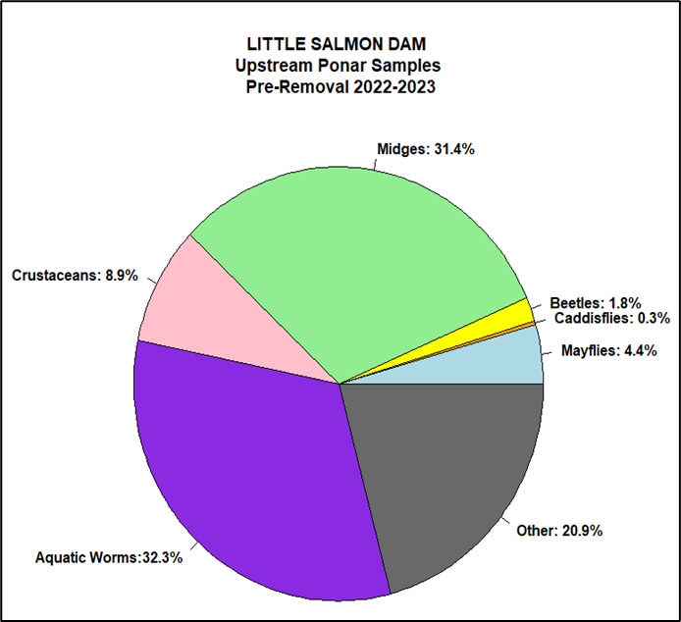
Data Analysis: Assessing community structure
Downstream populated by common invertebrates found in good quality streams.
Upstream populated by common pond organisms tolerant of fair to poor water quality.

Slide 17
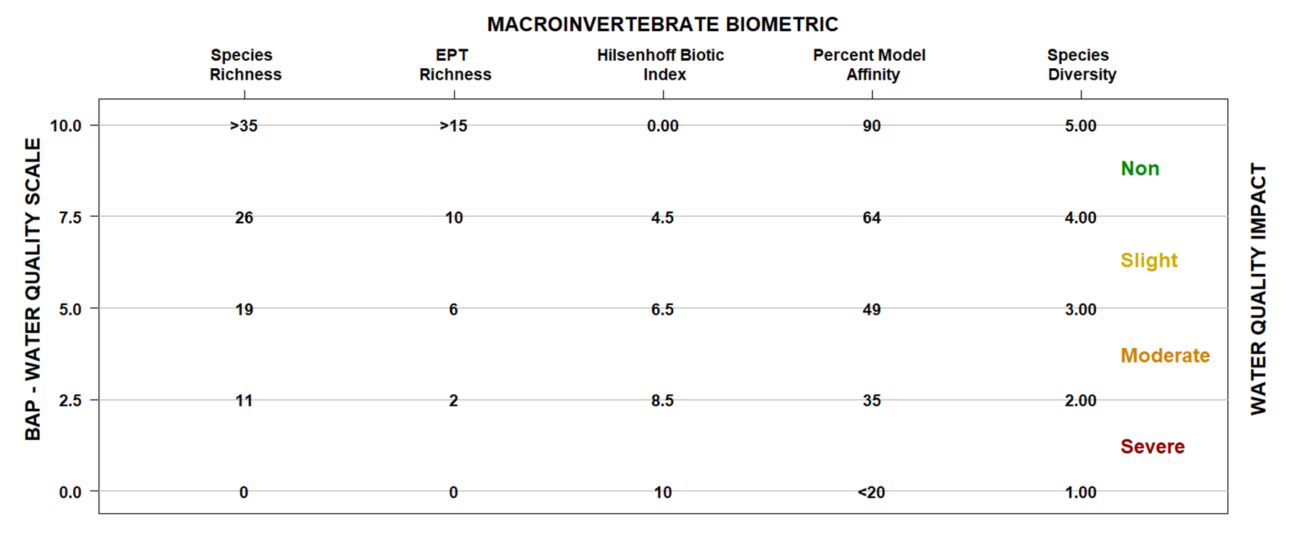
Data Analysis: Biometric Indices
Converting macroinvertebrate community composition information to quantitative water quality data. Each individual metric corresponds to a water quality score and impact designation associated with the NYS DEC Biological Assessment Profile (BAP) Score.

Slide 18
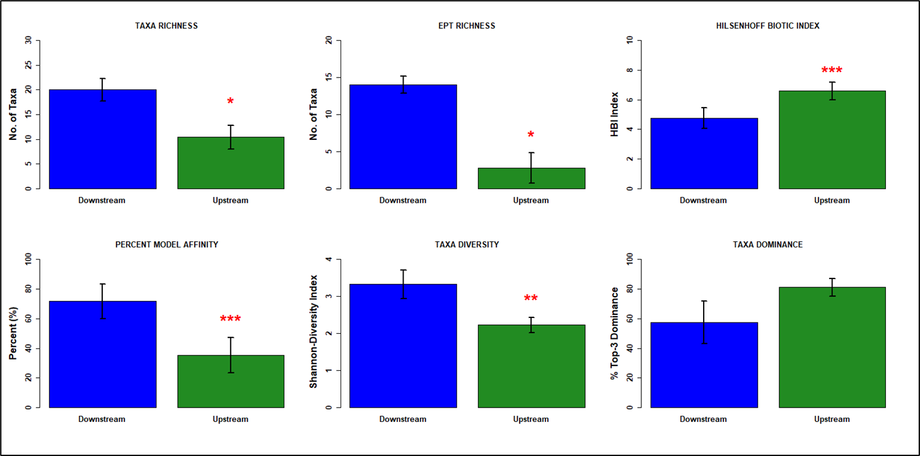
Data Analysis: Comparing Biometrics Across Locations
Awes Mill Dam biometric comparison between upstream impoundment and downstream reach in 2023.
The upstream location is consistently more impaired than downstream reach.

Slide 19
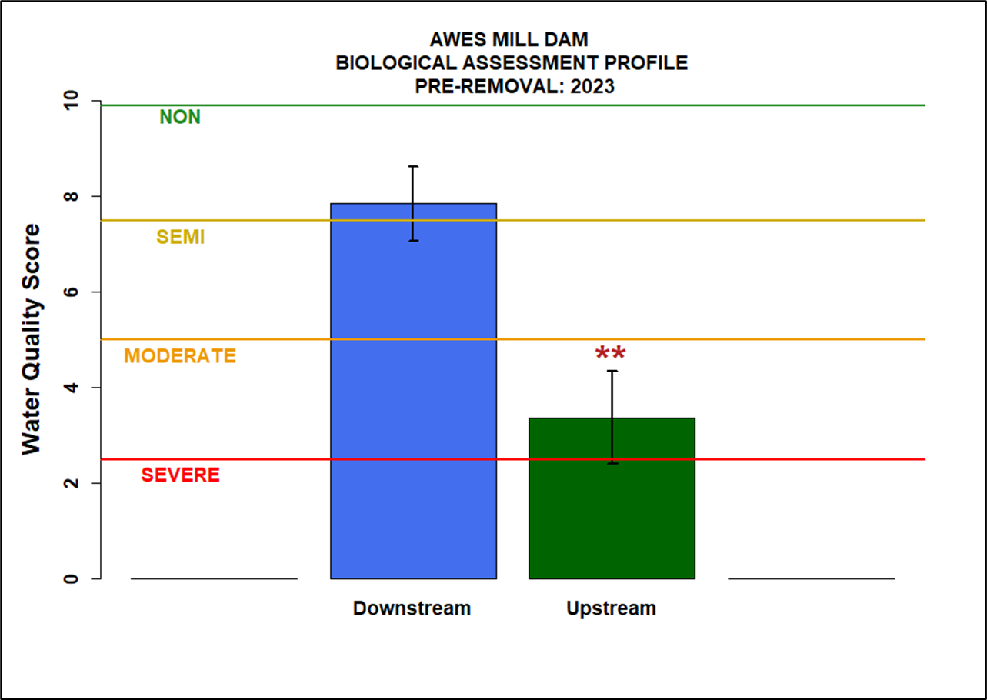
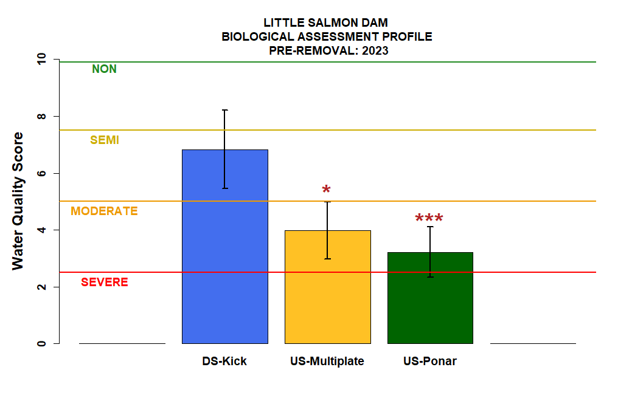
Data Analysis: BAP Water Quality Results
Upstream locations fall below the ‘Impaired Waterbodies’ threshold of a 5.0 water quality score.

Slide 20
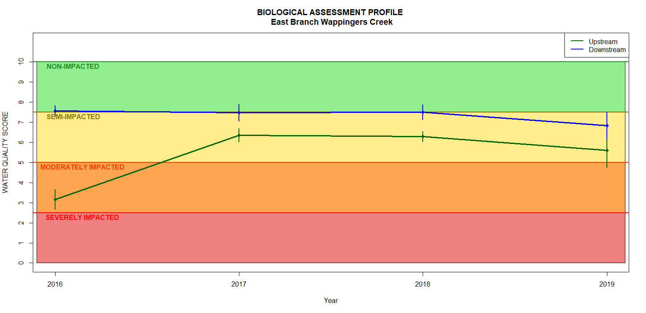
Monitoring Dissemination
Allows for the illustration of water quality trends resulting from management actions and documents successful restoration outcomes.
Example: Shapp Pond Dam, Dutchess County
| Dam Removed
Pre-Removal
Post-Removal →

Slide 21
THANK YOU FOR PARTICIPATING ? QUESTIONS ?

