Slide 1
Upstream Transition Following Poestenkill Dam Removal Rennsselear County, NY 2019 - 2021
Jeremy Dietrich
NYS Water Resources Institute
Cornell University
Ithaca, New York

Slide 2
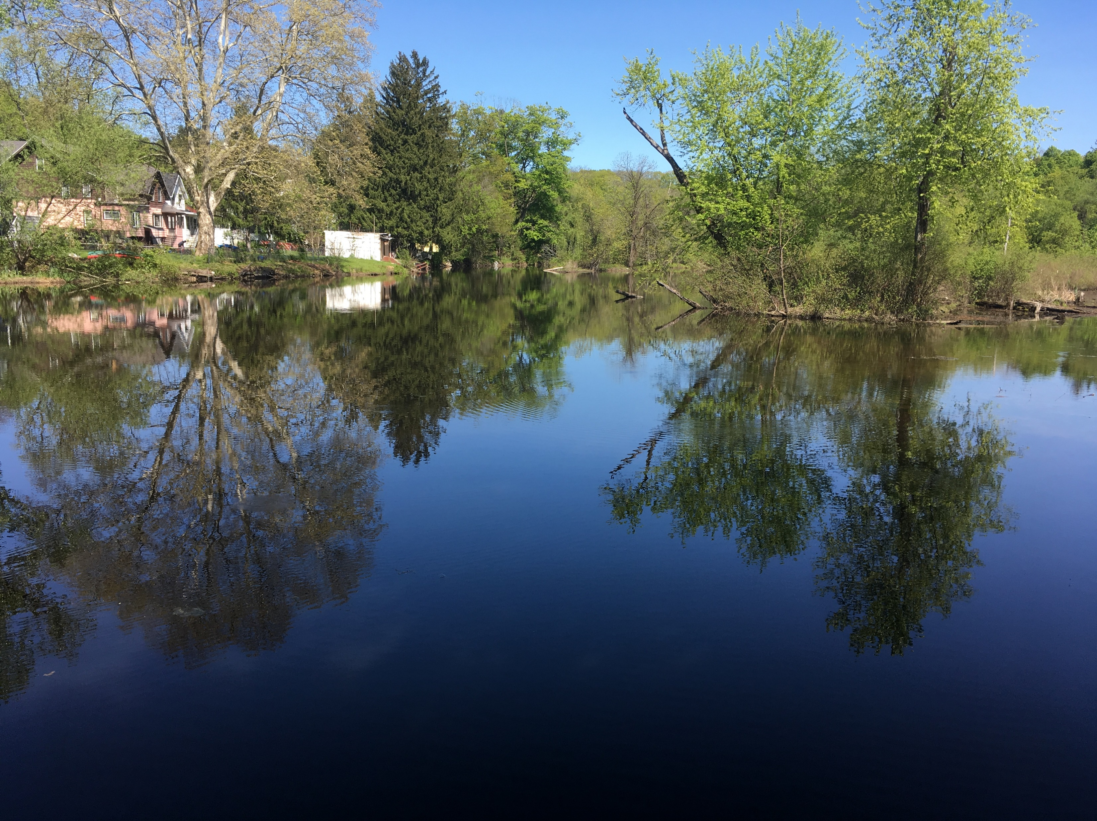
Intact Impoundment: June 2019

Slide 3
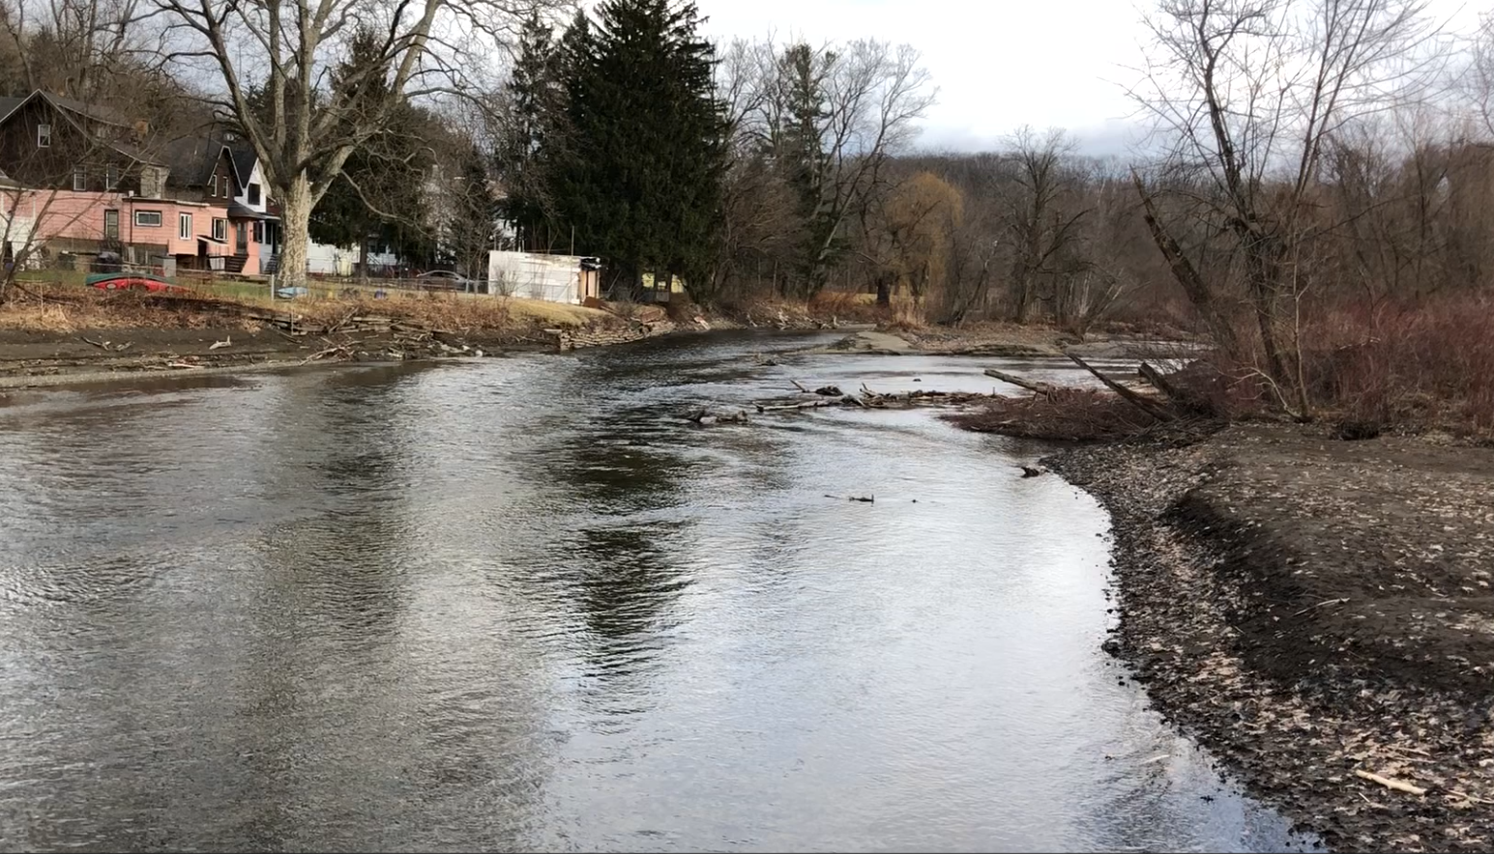
Dewatering Impoundment: January 2020

Slide 4
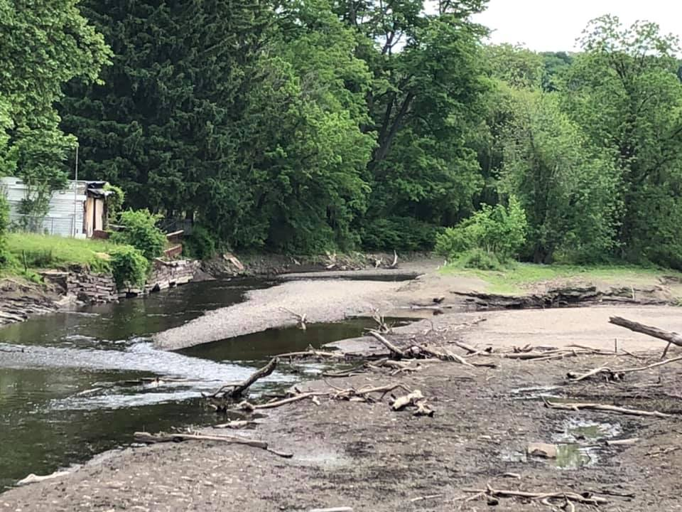
Dewatered Impoundment: June 2020

Slide 5
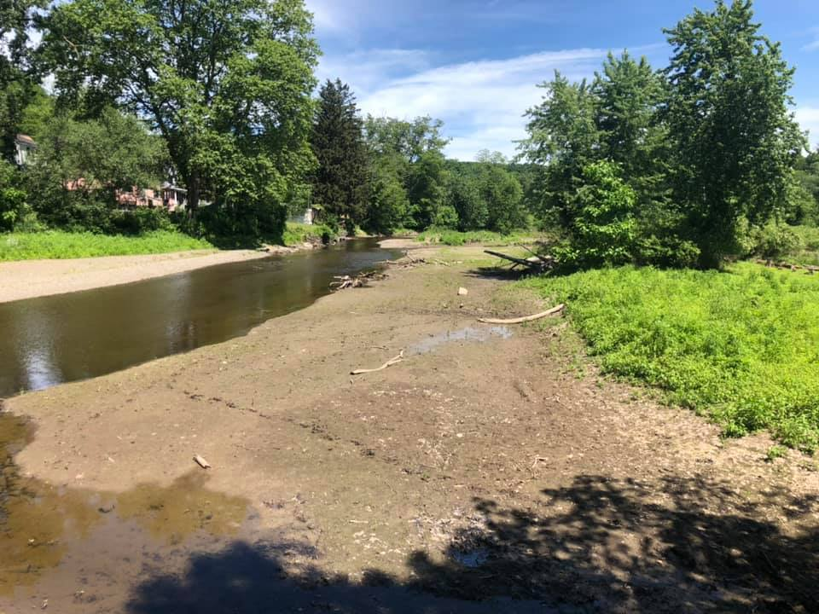
Former Impoundment: June 2021

Slide 6
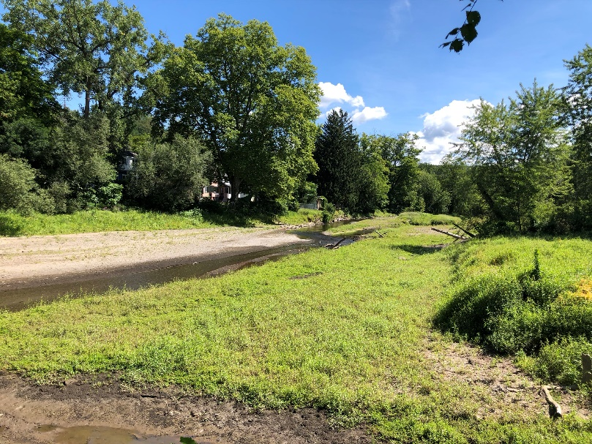
Former Impoundment: July 2021

